Slide 1






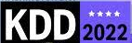
The Battlefront of Misinformation & Biased News
Yi R. Fung
Steeve Huang
Preslav Nakov
Heng Ji
KDD’22 Tutorial August 14, 2022

Slide 2

Outline
Introduction
Motivating Examples
Human Psychological Foundations on Impact and Effects
Detection
Fact-Checking
Semantic Inconsistency
Characterization
Bias & Framing
Applications &
Future Directions
Problem Definitions and Task Formulations
Social Context and Propagation Patterns
Intent & Agenda
Corrective Actions
Propaganda Techniques
Remaining Challenges
Future Directions
The Frontier in
Detection & Characterization
Methodologies
(Recent Trends, Pros & Cons, etc.)
Problem Definitions & Task Formulations
Remediative
Applications
& Directions
Fighting Fake
and/or
Biased News
Notes:
Nowadays, the practice of journalism often distributes news content via multimedia.

Slide 3
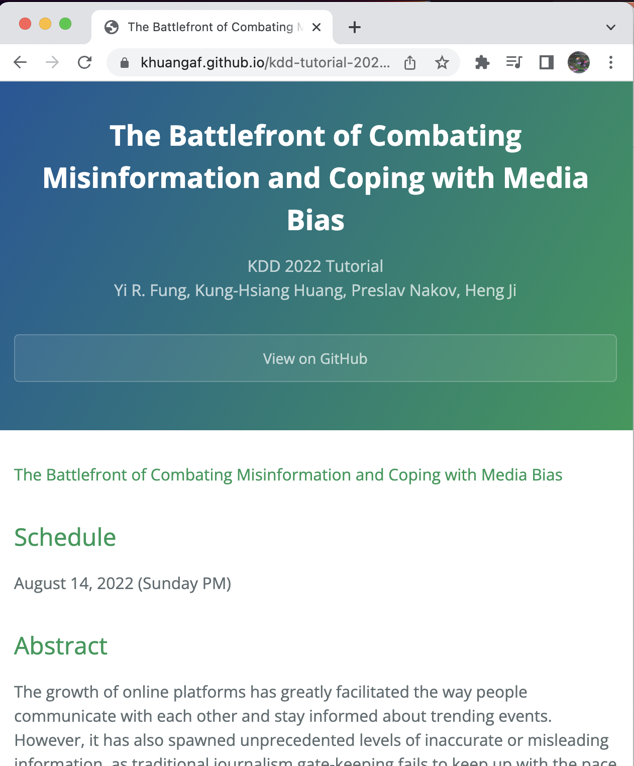
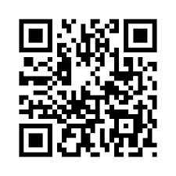
Before we begin! Some logistics…
You can find the slides at:
https://tinyurl.com/battlefront-fake-news-tutorial
Participation + Q&A
Coffee Break
11-11:15am (Eastern Time)
TODO
Notes:
Nowadays, the practice of journalism often distributes news content via multimedia.

Slide 4
Outline
Introduction
Motivating Examples
Human Psychological Foundations on Impact and Effects
Detection
Fact-Checking
Semantic Inconsistency
Characterization
Bias & Framing
Applications &
Future Directions
Problem Definitions and Task Formulations
Social Context and Propagation Patterns
Intent & Agenda
Corrective Actions
Propaganda Techniques
Remaining Challenges
Future Directions
The Frontier in
Detection & Characterization
Methodologies
(Recent Trends, Pros & Cons, etc.)
Problem Definitions & Task Formulations
Remediative
Applications
& Directions
Fighting Fake
and/or
Biased News
Notes:
Nowadays, the practice of journalism often distributes news content via multimedia.

Slide 5

Why we need this tutorial
Along With Online News and Social Media Came Information Pollution
We witnessed many fake news and biased news during Covid and the Russia Ukraine Crises
Pave a Roadmap Towards More Healthy Information Consumption
Multimedia news information extraction
Misinformation Detection
Misinformation Characterization
Cross-cultural Understanding
Low-resource Language Acquisition
Notes:
Nowadays, the practice of journalism often distributes news content via multimedia.

Slide 6

This tutorial, placed in perspective with previous tutorials
Misinformation is a continuous “cat and mouse game”
We witnessed many fake news and biased news during Covid and the Russia Ukraine Crises
TODO
Multimedia news information extraction
Cross-cultural Understanding
Low-resource Language Acquisition
Notes:
Nowadays, the practice of journalism often distributes news content via multimedia.

Slide 7
Outline
Introduction
Motivating Examples
Human Psychological Foundations on Impact and Effects
Detection
Fact-Checking
Semantic Inconsistency
Characterization
Bias & Framing
Applications &
Future Directions
Problem Definitions and Task Formulations
Social Context and Propagation Patterns
Intent & Agenda
Corrective Actions
Propaganda Techniques
Remaining Challenges
Future Directions
The Frontier in
Detection & Characterization
Methodologies
(Recent Trends, Pros & Cons, etc.)
Problem Definitions & Task Formulations
Remediative
Applications
& Directions
Fighting Fake
and/or
Biased News
Notes:
Nowadays, the practice of journalism often distributes news content via multimedia.

Slide 8




A Typical Fact Checking Pipeline
Debunked claims
Claim: The Amazon rainforest is decreasing.
Claim
Claim
Detector
Evidence Retriever
Claim
Verifier
webpage
True
article
Notes:
Style adapted from https://docs.google.com/presentation/d/1-oRiBwIxQAXG7VFqfsapBnbeDeIXKlkN3sSDkti8wpI/edit#slide=id.gfab536b173_0_167

Slide 9
A Typical Fact Checking Pipeline
Debunked claims
Claim Detection
Claim: The Amazon rainforest is decreasing.
Claim
Claim
Detector
Evidence Retriever
Claim
Verifier
webpage
True
article
Notes:
Make this figure to include all 4 tasks

Slide 10
A Typical Fact Checking Pipeline
Debunked claims
Checking against previously fact-checked claims.
Claim: The Amazon rainforest is decreasing.
Claim
Claim
Detector
Evidence Retriever
Claim
Verifier
webpage
True
article
Notes:
Make this figure to include all 4 tasks

Slide 11
A Typical Fact Checking Pipeline
Debunked claims
The setting of most fact checking datasets.
Claim: The Amazon rainforest is decreasing.
Claim
Claim
Detector
Evidence Retriever
Claim
Verifier
webpage
True
article
Notes:
Make this figure to include all 4 tasks

Slide 12
Claim Detection

Slide 13
Fact Checking Datasets

Slide 14





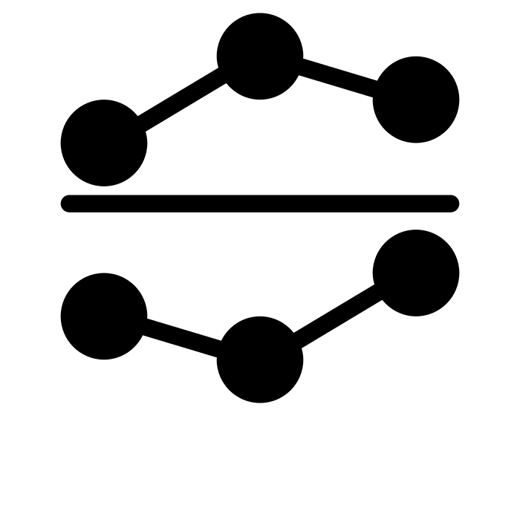
Fact Checking Datasets
A variety of fact checking datasets have been developed. They differ in:
Task formulation: given evidence v.s. open retrieval
Data source: fact checking website v.s. domain-specific literature
Types of evidence: Wikipedia v.s. news articles v.s. knowledge graph

Slide 15
Fact Checking Datasets
A variety of fact checking datasets have been developed. They differ in:
Task formulation: given evidence v.s. open retrieval
Data source: fact checking website v.s. domain-specific literature
Types of evidence: Wikipedia v.s. news articles v.s. knowledge graph

Slide 16
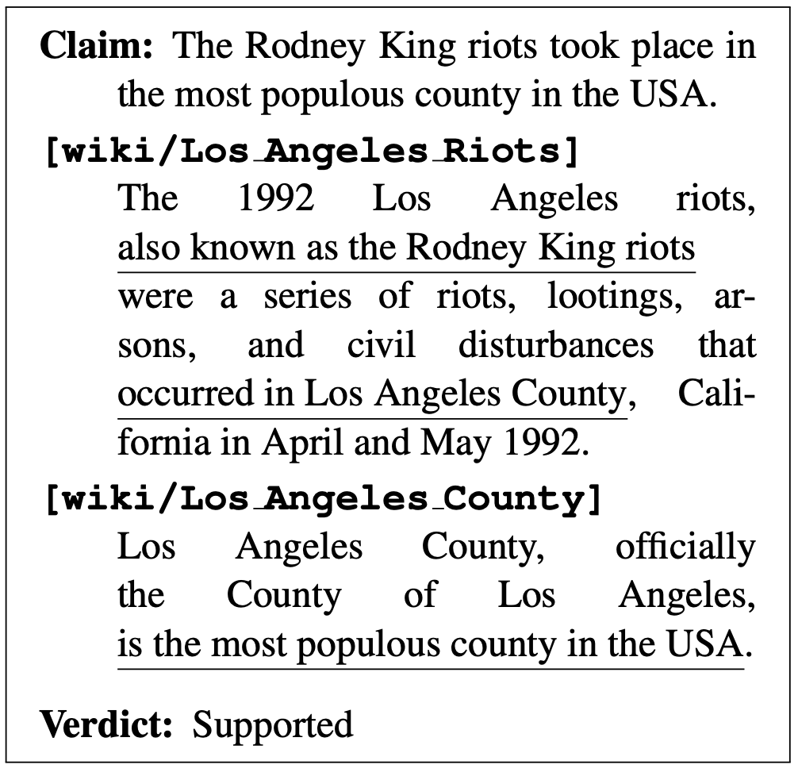
Given-evidence Fact Checking Datasets
Have better interpretability compared to the open-retrieval setting e.g. better understanding of which component is (not) working.
Assume the existence of relevant evidence in a small set of candidates, which may not be practical in real-world settings.
A few datasets have stance annotations (whether a stance refutes/supports a claim) e.g. FEVER [Thorne et al., 2018, NAACL], SciFact [Waddem et al., 2020, EMNLP].
FEVER [Throne et al. 2018, NAACL]

Slide 17
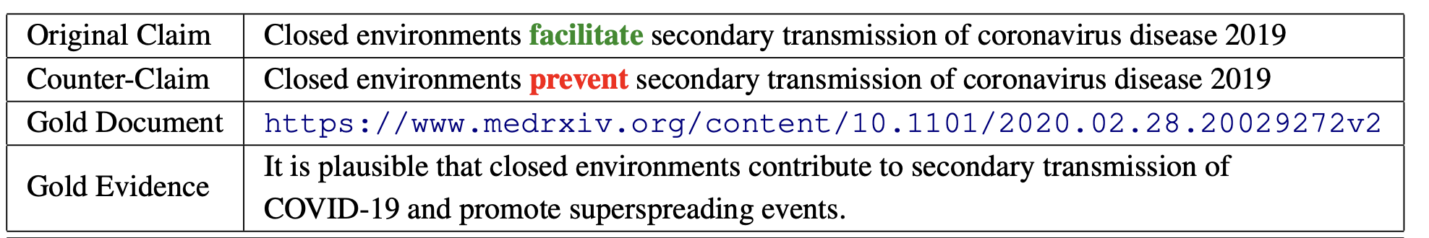
Given-evidence Fact Checking Datasets
An example from the COVID-Fact dataset [Saakyan et al., 2021, ACL]. Counter-claim is automatically generated with language models and a filtering algorithm.

Slide 18
Fact Checking Datasets
A variety of fact checking datasets have been developed. They differ in:
Task formulation: given evidence v.s. open retrieval
Data source: fact checking website v.s. domain-specific literature
Types of evidence: Wikipedia v.s. news articles v.s. knowledge graph

Slide 19
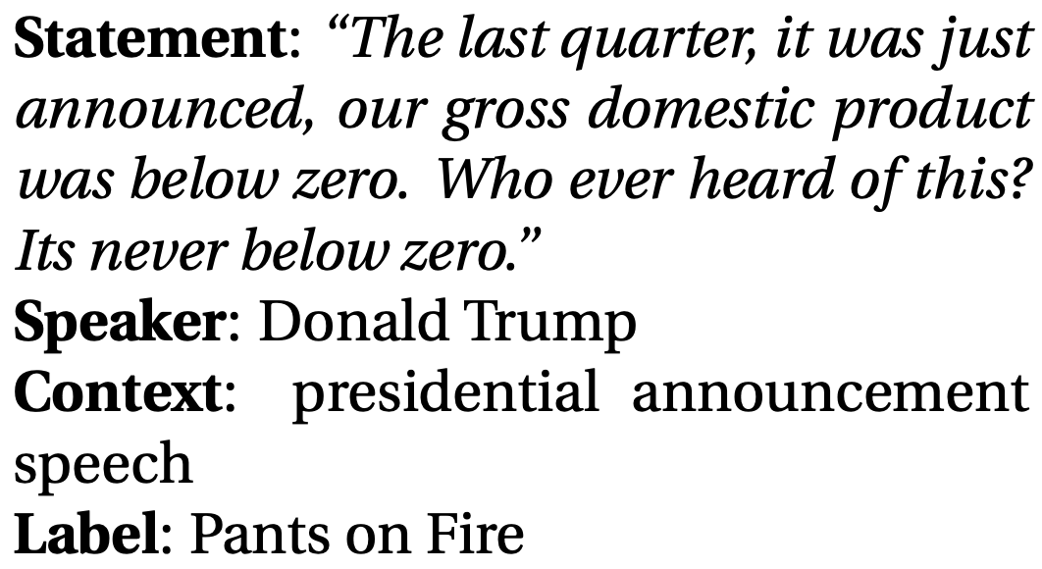
Open-retrieval Fact Checking Datasets
Relevant evidence is not provided.
Fact checkers are required to seek information from the web or external database.
How and where to retrieve useful information become problems.
Some work attempted to predict the veracity of the claim simply based on the claim [Gupta et al., 2021, ACL] or claim and metadata [Wang et al. 2017, ACL] without retrieval.
The claims in these datasets are often crawled from fact checking websites.
LIAR [Wang et al. 2017, ACL]

Slide 20
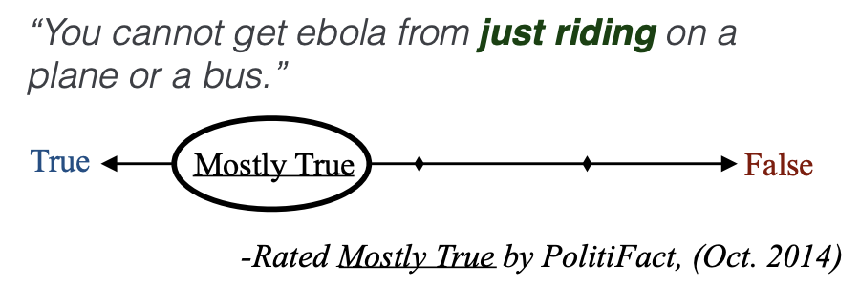
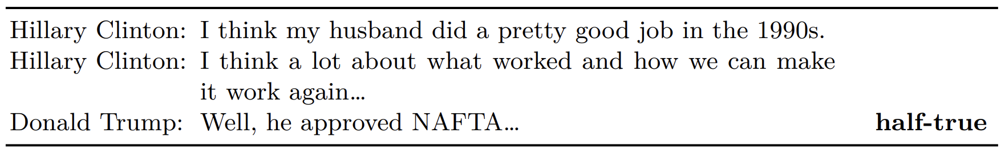
Open-retrieval Fact Checking Datasets
An example from TSHP-17 [Barron-Cedeno et al., 2017, EMNLP]
An example from CheckThat18-T2 [Barron-Cedeno et al., 2018, CLEF]

Slide 21
Multilingual Fact Checking Datasets
Few studies develop multilingual fact checking.
Some research focus on fact checking other than English:
Arabic: [Baly et al., 2018, NAACL] [Khouja 2020, FEVER workshop]
Danish: [Lillie et al, 2019, NoDaLiDa] [Nørregaard et al., 2021, NoDaLiDa]
X-Fact [Gupta et al., 2021, ACL] is the first dataset enables research on cross-lingual transfer for fact checking.

Slide 22
Challenges of Fact Checking Datasets
Unverifiable claims
Assumptions of the existence of relevant evidence
Choice of labels
Dataset biases

Slide 23
Unverifiable Claims
Some claims are not verifiable because:
there is not enough evidence publicly available.
there is enough evidence but the evidence is contradictory.
Recently released datasets, such as X-Fact [Gupta et al., 2021, ACL], address this issue by introducing a “non-verifiable” class label.

Slide 24
Assumptions of the Existence of Relevant Evidence
In the given-evidence setting, it is assumed that relevant evidence can be found in the small set of evidence pool.
In real-world setting, however, new claim may not have any relevant evidence at all. Such assumption becomes invalid.

Slide 25
Choice of Labels
Recent datasets introduced fine-grained veracity labels, some may include up to 40 classes [Augenstein et al., 2019, EMNLP], quantifying various amount of false information in the claim.
It is not non-trivial to determine the “falsehood” of a claim and may subject to the bias of annotation processes and annotators.
Possible solution: Avoid introducing too many noisy labels or normalize the labels.
A true claim can still be misleading by cherry picking parts of a fact or presenting information in a misleading way [Guo et al., 2021, TACL].
Possible solution: Integrate propaganda detection technique into the fact checking process.

Slide 26
Dataset Biases
Studies [Schuster et al., 2019, EMNLP] have shown that fact checking models often exploit bias in synthetic datasets, such as FEVER [Throne et al., 2018, NAACL].
Possible solutions:
Debais the dataset [Mahabadi et al., 2020, ACL]
Debias the model without dropping performance much [Utama et al., 2020, ACL]
Employ adversarial training with a attack model such as [Niewinski et al., 2019, FEVER Workshop]
Notes:
Talk about what kind of biases.

Slide 27
Fact Checking Methods

Slide 28
Fact Checking Models
Despite the difference in input types and task forumluation, most fact checking models contain two major components:
Evidence retriever:
Retrieve relevant information from the web or a small set of candidates.
Claim verifier:
Verify the compatibility between the retrieved evidence and the input claim.

Slide 29
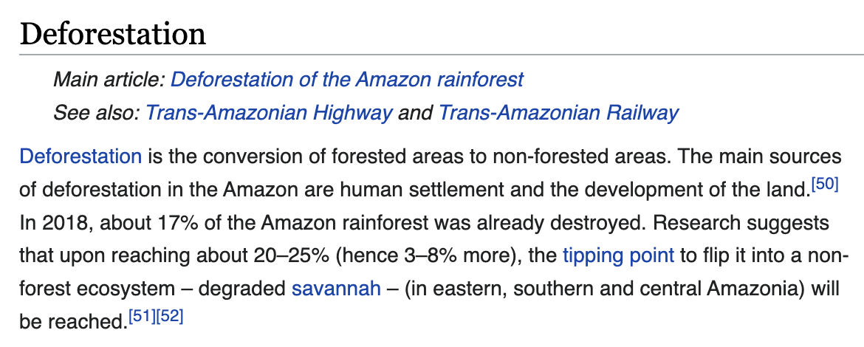
Fact Checking Models
Claim: The Amazon rainforest is decreasing.
Evidence Retriever
Claim Verifier
True
Notes:
Make this figure to include all 4 tasks

Slide 30

Fact Checking Models
Claim: The Amazon rainforest is decreasing.
Evidence Retriever
Answer
Selector
Claim Verifier
Paragraph
Sentence
True
Depending on the granularity of the evidence retrieved, some methods adopt an additional answer selector module to extract the important part of the evidence, such as [Wadden et al., 2020, EMNLP] [Pradeep et al., 2021, LOUHI].
Notes:
Make this figure to include all 4 tasks

Slide 31
Evidence Retriever
BM25 [Robertson et al., 2009, Now Publishers Inc.]
Lexical overlap approach based on TF-IDF.
Search engine
Extract snippets from the search engine results queried with the input claim.
Dense Passage Retriever (DPR) [Karpukhin et al., 2020, EMNLP]
A dual-encoder architecture that separately encode the claim and evidences.
Inner product is used to select the most relevant evidence.
Language model
Learns to predict whether a claim-evidence pair is relevant. → higher computation complexity
Only applicable in the given-evidence setting.

Slide 32

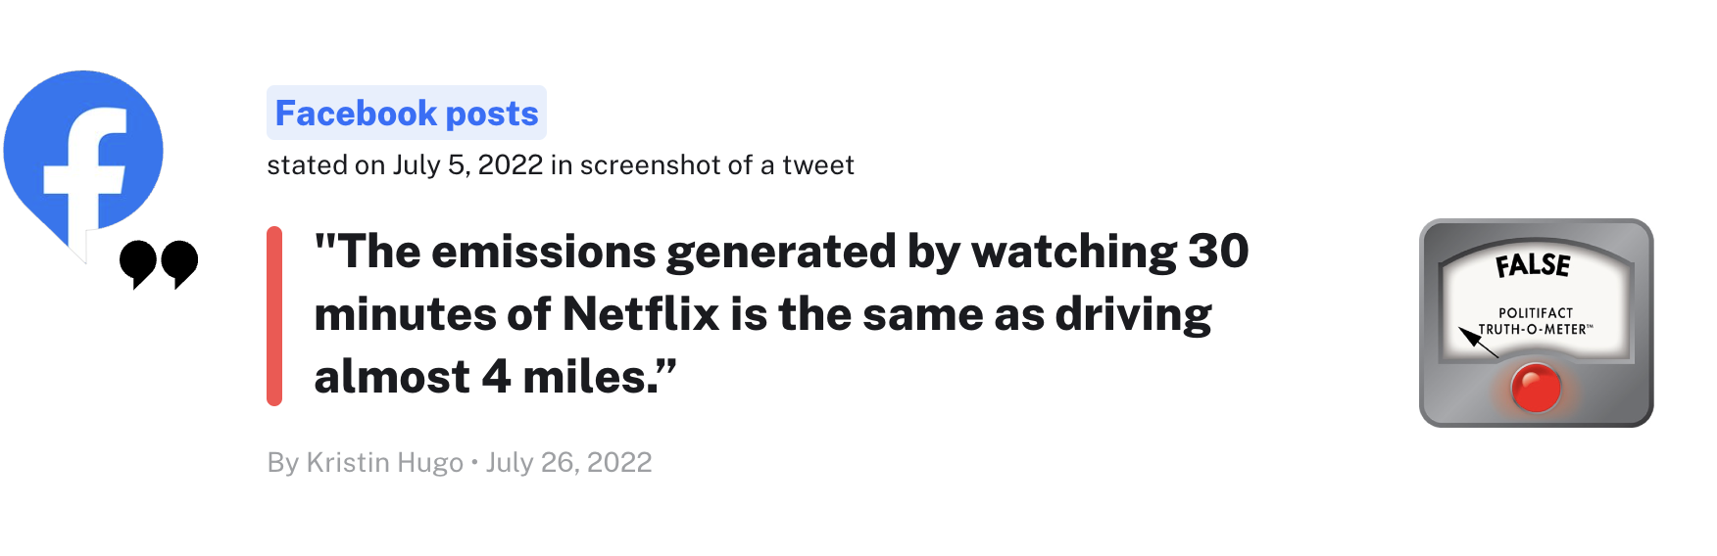
Issues Of Using Search Engine as Evidence Retriever
Since many datasets are collected from fact checking websites, querying search engine with the fact checked claims will likely return the fact checking web pages where the claim was collected. This may lead to deceivingly good performance but poor generalizability to new claims that are not fact checked.
Solution: restrict the domain from which the search engine retrieve information.
The emissions generated by watching 30 minutes of Netflix is the same as driving almost 4 miles.
Image from politifact.com

Slide 33

DPR [Karpukhin et al., 2020, EMNLP]
Claim
Inner Product
Documents are split into chunks of texts (passages) as evidences.
Relevancy of a claim and a passage is measured via inner product.

Slide 34
Using DPR for Open-retrieval Fact Checking
A naive approach is to directly use the DPR checkpoints trained on open-domain QA datasets.
Yet, domain mismatch/discrepancy exists:
Fact checking: queries are claims
Question answer: queries are questions
Possible solutions:
Fine-tune DPR on silver-quality data generated by approaches similar to QAGen [Shakeri et al., 2020, EMNLP].
Refine representations of queries (claim) and passages with contrastive learning or the Inverse Cloze Task [Izacard et al., 2022, arxiv] [Huang et al., 2022, submission].

Slide 35
Which retriever is the most effective?
Evidence Retriever | Recall@3 | Recall@5
BM25 | 79.90 | 84.69
T5 (MS Marco) | 86.12 | 89.95
T5 (MS Marco Med) | 85.65 | 89.00
T5 (SciFact) | 86.60 | 89.40
T5 outperforms BM25 when trained on smaller-scale in-domain or larger-scale out-of-domain data.
Recall comparison between T5 and BM25 abstract retrieval methods on the development set of the SciFact dataset. [Pradeep et al., 2021, LOUHI]

Slide 36
Which retriever is the most effective?
Evidence Retriever | Seen Languages | Unseen Languages
BM25 | 38.29 | 17.43
Google Search | 42.61 | 16.02
MT + DPR | 35.29 | 15.01
mDPR [Asai et al., 2021, NeurIPS] | 36.79 | 17.60
Google Search performs very well in fact checking claims in seen languages but not so much in the zero-shot setting, likely due to the issue discussed previously.
mDPR, a multilingual version of DPR, is the most ideal for zero-shot cross-lingual fact checking.
Fact checking performance on X-Fact in F1 (%). All methods use mBERT as the claim verifier. [Huang et al., 2022, submission]

Slide 37

Claim Verifier
The most popular choice is to pass in the top-ranked evidences and the claim to a pre-trained language model to perform classification.
Studies have shown that using T5 outperforms other language models, likely due to the wide variety of tasks T5 was pre-trained on [Pradeep et al., 2021, LOUHI].
Claim
Verdict
Evidence

Slide 38
Challenges of Fact Checking Models
Resolving claims with under-specified context
Mitigating diachronic bias
Justifying verdicts

Slide 39
Resolving Claims With Under-specified Context
Claims that provide only limited information is challenging to verify.
For example,
“Do not believe that our partners, the US and NATO are informed either, because I would be informed as well.”
→ We do not know who is “I” and what information should “I” be informed.
Possible solutions:
Utilize a fact-enhanced generator to augment the context. [Shu et al., 2021, AAAI]
Mining the original context from the internet. [Huang et al., 2022, submission]

Slide 40
Mitigating Diachronic Bias
Fact checking systems may subject to the period of time in which the training data was constructed.
For example, a model learned from a dataset collected in 2017 is difficult to correctly fact checking claims about “COVID-19”.
This could lead to failure in verifying “new” rumors and breaking news, known as the “diachronic bias” problem.
Studies demonstrated the effectiveness of addressing such bias by masking time-sensitive terms in the training data [Murayama et al., 2021, W-NUT].
Another possible solution is to validate the credibility of the news source [Baly et al., 2020, ACL]

Slide 41
Justifying Verdicts
The majority of the fact checking studies do not offer explainability.
“Debunking purely by calling something false often fails to be persuasive…” [Guo et al., 2021, TACL]
One solution is “rule mining as explanations” [Ahmadi et al., 2019, Arxiv]
A claim is true if all variables and rules can be derived from a knowledge base/graph.
→ limited to logical rules defined by the knowledge base.
Another approach is “text generation as explanations”:
Frame the explanation problem as a summarization task in which the model takes in ruling comments and extractively generates explanation. [Atanasova et al., 2020, ACL]
→ assume ruling comments are available, which often are not.
Generate explanations based on claim and evidence only [Kotonya et al., 2020, EMNLP]

Slide 42
Fact Checking Takeaways
Fact checking models typically consists of an evidence retriever and a claim verifier.
Several challenges in fact checking datasets call for solutions:
Unverifiable claims
Assumptions of the existence of relevant evidence
Choice of labels
Dataset biases
Possible future fact checking research directions include:
How to verify claims with under-specified context?
How to mitigate diachronic bias?
How to produce faithful verdict justification/explanation?

Slide 43
Special Notes on Neural Fake News Generation & Detection

Slide 44
The Double-edge of Fake News Generation
The rise of pre-trained sequence-to-sequence models allows for generating coherent texts.
Machine-generated fake news becomes even more believable and look like human-written ones.
Downside: Malicious parties may take advantage of such techniques for hostile purposes.
Upside: Studies have shown that detectors derived from such generators excel in identifying their own generated fake articles. [Zellers et al., 2019, NeurIPS]
→ The majority of recent work developed detectors based on synthetic data.

Slide 45
Research Questions
Ultimate objective: Generate fake news that can benefit detection most.
How to generate fake news that requires knowledge-element level reasoning?
How to generate fake news that better aligns with factual knowledge?
How to generate fake news that are closer to human-written ones in terms of style and underlying intent.

Slide 46
Research Questions
Ultimate objective: Generate fake news that can benefit detection most.
How to generate fake news that requires knowledge-element level reasoning?
How to generate fake news that better aligns with factual knowledge?
How to generate fake news that are closer to human-written ones in terms of style and underlying intent.

Slide 47


KG-conditioned Fake News Generation: Training
Train a conditional generation model to perform graph-to-text generation.
The generator learns to generate the corresponding article given a graph of knowledge elements extracted by an IE system.
Information Extraction
Original
article
Knowledge
elements
BART
[Fung et al., 2021, ACL]

Slide 48
KG-conditioned Fake News Generation: Inference
Information Extraction
In inference time, fake articles can be generated by feeding manipulated knowledge elements into the generator.
Knowledge
elements
Original
article
Manipulates
Manipulated
knowledge
elements
Fake
article
BART
[Fung et al., 2021, ACL]
Notes:
Introduce what types of manipulation can be used.

Slide 49
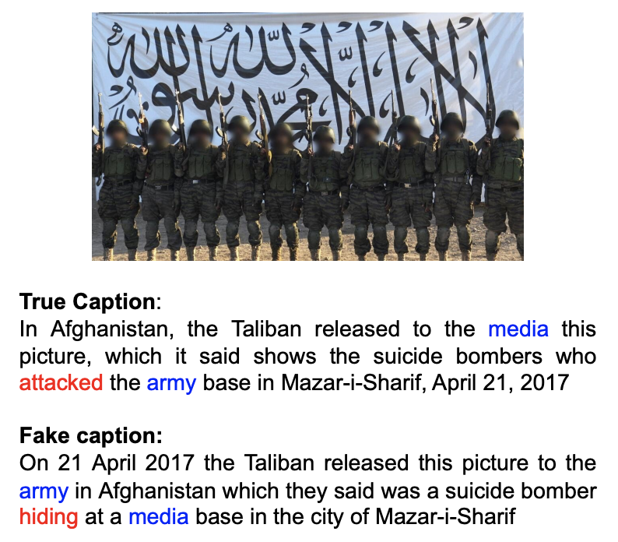
KG-conditioned Fake News Generation: Example
An example of the fake news generated by the KG- conditioned generator.
[Fung et al., 2021, ACL]

Slide 50
Research Questions
Ultimate objective: Generate fake news that can benefit detection most.
How to generate fake news that requires knowledge-element level reasoning?
How to generate fake news that better aligns with factual knowledge?
How to generate fake news that are closer to human-written ones in terms of style and underlying intent.

Slide 51
Fact-Enhanced Synthetic News Generation: Training
Masked claims
Claim Reconstructor
Claim
Original article
Fact Retriever
Relevant facts
Encoder
Decoder
Fact collection
The model learns to generate an article based on an extracted claim from it.
To ensure factuality, the decoder representations is used to reconstruct the extracted claim.
Original article
[Shu et al., 2021, AAAI]
Notes:
Facts are collected from training data. This work assumes that the availability of factually correct claims in the training data.

Slide 52
Fact-Enhanced Synthetic News Generation: Training
Masked claims
Claim Reconstructor
Claim
Original article
Conditional news generation
Fact Retriever
Relevant facts
Encoder
Decoder
Fact collection
The model learns to generate an article based on an extracted claim from it.
To ensure factuality, the decoder representations is used to reconstruct the extracted claim.
Original article
[Shu et al., 2021, AAAI]
Notes:
Facts are collected from training data. This work assumes that the availability of factually correct claims in the training data.

Slide 53
Fact-Enhanced Synthetic News Generation: Training
Claim reconstruction
Masked claims
Claim Reconstructor
Claim
Original article
Fact Retriever
Relevant facts
Encoder
Decoder
Fact collection
The model learns to generate an article based on an extracted claim from it.
To ensure factuality, the decoder representations is used to reconstruct the extracted claim.
Original article
[Shu et al., 2021, AAAI]
Notes:
Facts are collected from training data. This work assumes that the availability of factually correct claims in the training data.

Slide 54
Fact-Enhanced Synthetic News Generation: Inference
Fake claim
Fact Retriever
Relevant facts
Encoder
Decoder
Fact collection
Given a fake claim, the model can retrieve relevant facts that allows for generation of a believable story.
Fake article
[Shu et al., 2021, AAAI]
Notes:
Facts are collected from training data. This work assumes that the availability of factually correct claims in the training data.

Slide 55
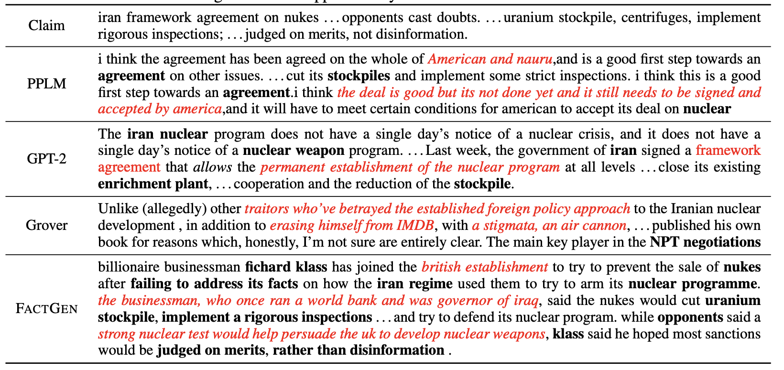
Fact-Enhanced Synthetic News Generation: Example
Comparison of fake news generated by different approaches.
[Shu et al., 2021, AAAI]

Slide 56
Research Questions
Ultimate objective: Generate fake news that can benefit detection most.
How to generate fake news that requires knowledge-element level reasoning?
How to generate fake news that better aligns with factual knowledge?
How to generate fake news that are closer to human-written ones in terms of style and underlying intent.

Slide 57
Generate Fake News Similar to Human-written Ones
Studies show that:
The majority of human-written fake articles only contain 1-2 incorrect sentences.
Around 33% of the human-generated fake news contain propaganda.
[Huang et al., 2022, submission]
Notes:
Bad title :(

Slide 58
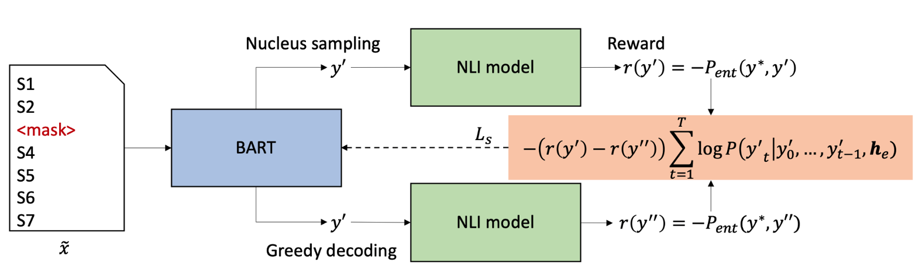
Generate Fake News Similar to Human-written Ones
Generate fake news by replacing part of an authentic article with inaccurate sentences that are plausible.
To ensure the generated sentence is invalid, self-critical sequence training [Rennie et al., 2017, CVPR] is adopted.
[Huang et al., 2022, submission]

Slide 59
Generate Fake News Similar to Human-written Ones
The work is able to generate two types of propaganda techniques:
Loaded language: trigger the audience’s emotion with strong terms.
e.g. He is a cunning politician.
Appeal to authority: strengthen an argument by referring to a statement made by experts or authorities.
e.g. According to the immunologists, masks do not save life!
[Huang et al., 2022, submission]

Slide 60
Generate Fake News Similar to Human-written Ones
Generating Appeal to Authority:
Train a model that learns where to insert a <mask> in a given sentence.
Train another model that fill in the <mask> with an emotion-triggering adjective or adverb.
“He is a politician.”
↓
“He is a <mask> politician.”
↓
“He is a cunning politician.”
[Huang et al., 2022, submission]

Slide 61
Generate Fake News Similar to Human-written Ones
Generating Loaded Language:
Reuse the BART model that was fine-tuned for fake news generation.
Prompt the decoder with XXX confirms that “, where XXX can be an expert or a public figure.
S1
S2
S3
S4’
<mask>
S5
S6
S7
S8
Encoder
Decoder
XXX confirms that “
Perturbed article
[Huang et al., 2022, submission]

Slide 62
Generate Fake News Similar to Human-written Ones
Detector | Training Data | Accuracy (%)
GROVER-Large | PropaNews (gold) | 66.8
 | PropaNews (silver) | 62.1
 | GROVER-generated | 59.5
RoBERTa-Large | PropaNews (gold) | 66.9
 | PropaNews (silver) | 61.8
 | GROVER-generated | 54.9
The same detector trained on PropaNews is significantly better at detecting human-written fake news.
Human validation is also crucial for improving the detection performance on human crafted fake articles.
Performance of detectors trained on various training sets and test on the human-written news articles.
[Huang et al., 2022, submission]

Slide 63
Takeaways
Fake news generation techniques are effective methods for enhancing performance on detecting fake news. Yet, such techniques should be used with cautions and aware of misuse.
Recent directions of fake news generation includes:
Generating fake news datasets that requires knowledge-element level reasoning.
Generating fake news that is supported by facts.
Generating fake news that is closer to human-written ones in terms of styles and intents.

Slide 64
Outline
Introduction
Motivating Examples
Human Psychological Foundations on Impact and Effects
Detection
Fact-Checking
Semantic Inconsistency
Characterization
Bias & Framing
Applications &
Future Directions
Problem Definitions and Task Formulations
Social Context and Propagation Patterns
Intent & Agenda
Corrective Actions
Propaganda Techniques
Remaining Challenges
Future Directions
The Frontier in
Detection & Characterization
Methodologies
(Recent Trends, Pros & Cons, etc.)
Problem Definitions & Task Formulations
Remediative
Applications
& Directions
Fighting Fake
and/or
Biased News
⭐
Notes:
Nowadays, the practice of journalism often distributes news content via multimedia.

Slide 65


Semantic Inconsistency for Misinformation Detection
Definitions:
At it’s core, compared to fact-checking, which seeks to verify the truthfulness of individual claims, semantic inconsistency takes on a more holistic approach and aims to capture lack of trustworthiness existing in any part of a news article.

Slide 66
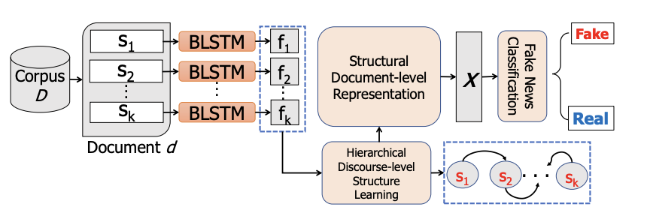
First, Let’s Focus on Intra-Document Uni-Modality Fake News Semantic Inconsistency Detection…
A “Traditional Approach” from 3-4 Years Ago:
Use structure representation as a way to capture the complex information conveyed in news article
The “discourse-level” refers to individual sentences, which is coarser than information elements (e.g., events/entities, relations)
Karimi, H and Tang, J. Learning Hierarchical Discourse-Level Structures for Fake News Detection. Proceedings of the 2019 Conference of the North American Chapter of the Association for Computational Linguistics: Human Language Technologies (NAACL-19).

Slide 67
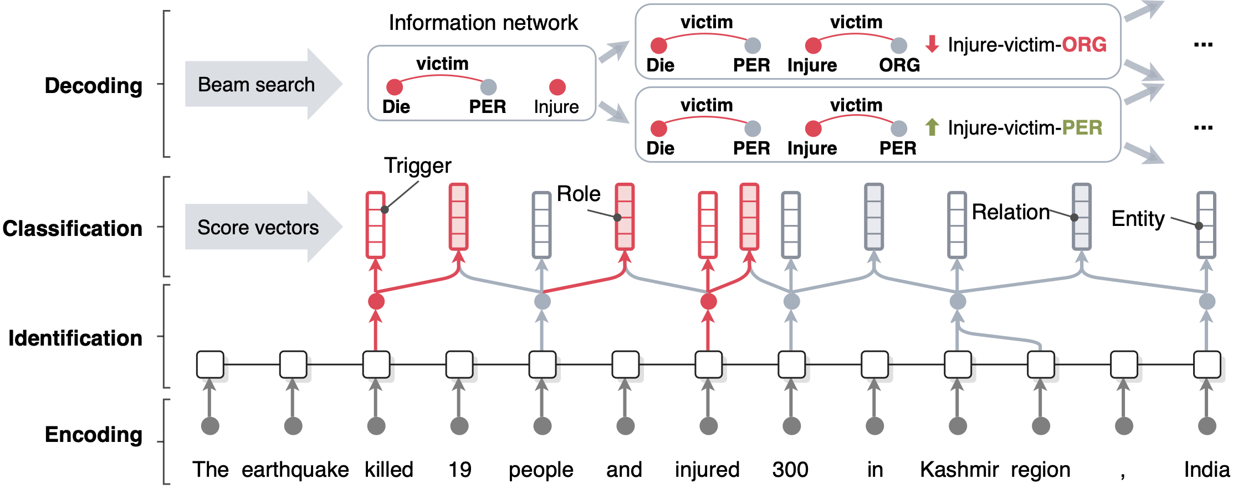
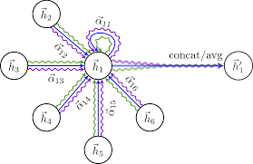
Since then, relevant studies have explored finer-grained and more expressive approaches for the detection task
The recent trends include:
Event
Entity
Relations
AMR
Previously,
More Recently,
BERT
Finer-Grained Structured Representation of News Content
Leveraging More Expressive Encoders (Feature Extractors)
Multi-Layer Graph Attention Networks
Multi-media/multi-modality info
Established background knowledge
Reader Response
Cross-document info
Using More Expressive Reasoning Architectures in the Model
Incorporating Additional Context

Slide 68
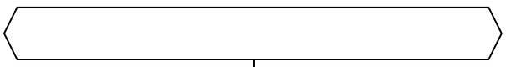
Categorization of Semantic Consistency-based Fake News Detection
Semantic Consistency for Fake News Detection
Within-Document
Multi-Media
Est’d Background Knowledge
Context Awareness
Attention-Guided
Cross-Modal Interaction
Textual Knowledge
Cross-Doc
News Cluster
CLIP encoders
Structural Knowledge
Reader
Comments
IE/AMR graph reasoning
Heterogeneous
Representation
Propagation Pattern
Multi-Frame Pooling for Videos
Entity/Event/
Claim Level Linking
User Preference

Slide 69
Categorization of Semantic Consistency-based Fake News Detection
Semantic Consistency for Fake News Detection
Within-Document
Multi-Media
Est’d Background Knowledge
Context Awareness
Attention-Guided
Cross-Modal Interaction
Textual Knowledge
Cross-Doc
News Cluster
CLIP encoders
Structural Knowledge
Reader
Comments
IE/AMR graph reasoning
Heterogeneous
Representation
Propagation Pattern
Multi-Frame Pooling for Videos
Entity/Event/
Claim Level Linking
User Preference
Check for de-contextualization between txt-img, txt-video, etc.

Slide 70
Categorization of Semantic Consistency-based Fake News Detection
Semantic Consistency for Fake News Detection
Within-Document
Multi-Media
Est’d Background Knowledge
Context Awareness
Attention-Guided
Cross-Modal Interaction
Textual Knowledge
Cross-Doc
News Cluster
CLIP encoders
Structural Knowledge
Reader
Comments
IE/AMR graph reasoning
Heterogeneous
Representation
Propagation Pattern
Multi-Frame Pooling for Videos
Entity/Event/
Claim Level Linking
User Preference
Capture concurrent info and causal reactions; Achieve explainability and customizability

Slide 71
Categorization of Semantic Consistency-based Fake News Detection
Semantic Consistency for Fake News Detection
Within-Document
Multi-Media
Est’d Background Knowledge
Context Awareness
Attention-Guided
Cross-Modal Interaction
Textual Knowledge
Cross-Doc
News Cluster
CLIP encoders
Structural Knowledge
Reader
Comments
IE/AMR graph reasoning
Heterogeneous
Representation
Propagation Pattern
Multi-Frame Pooling for Videos
Entity/Event/
Claim Level Linking
User Preference
Compare Info w/ FreeBase, Wikipedia, Fact-Checking Webpages, etc.

Slide 72
Categorization of Semantic Consistency-based Fake News Detection
Let’s start (here)…
Semantic Consistency for Fake News Detection
Within-Document
Multi-Media
Est’d Background Knowledge
Context Awareness
Attention-Guided
Cross-Modal Interaction
Textual Knowledge
Cross-Doc
News Cluster
CLIP encoders
Structural Knowledge
Reader
Comments
IE/AMR graph reasoning
Heterogeneous
Representation
Propagation Pattern
Multi-Frame Pooling for Videos
Entity/Event/
Claim Level Linking
User Preference
Compare Info w/ FreeBase, Wikipedia, Fact-Checking Webpages, etc.

Slide 73
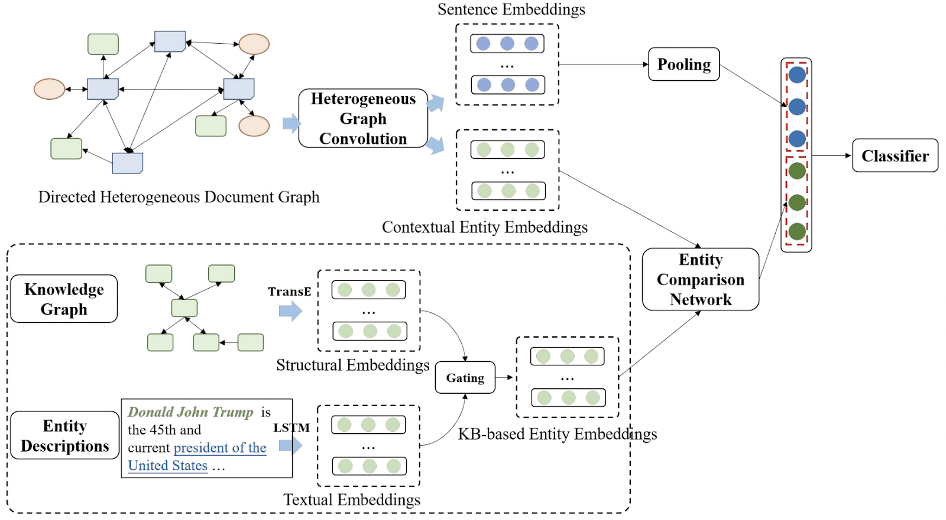

Semantic Consistency w.r.t. Background Knowledge for Fake News Detection
Overall picture:
Given an input document
Goal: Compare
Information Elements
Given background knowledge
Notes:
The goal is to compare information elements

Slide 74
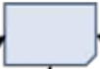
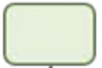
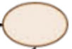
Semantic Consistency w.r.t. Background Knowledge for Fake News Detection
Sentence Node
Entity Node
Topic Node
Mined through LDA
Selected top k=100 latent topics from corpus
Ex: campaign, election
Hu, J and Yang, T. and Zhou, M. Compare to The Knowledge: Graph Neural Fake News Detection with External Knowledge. Proceedings of the Association of Computational Linguistics (ACL-21).

Slide 75

Semantic Consistency w.r.t. Background Knowledge for Fake News Detection
Link entities to background knowledge, through tools such as TAGME (or alternatively, RESIN)
The entity comparison operator is defined as:
$$f=W[e_{c}−e_{KB},e_{c}⊙e_{KB}]$$
Hu, J and Yang, T. and Zhou, M. Compare to The Knowledge: Graph Neural Fake News Detection with External Knowledge. Proceedings of the Association of Computational Linguistics (ACL-21).

Slide 76
Semantic Consistency w.r.t. Background Knowledge for Fake News Detection
(max)
Finally, concatenate the news document features and information comparison features for classification
Hu, J and Yang, T. and Zhou, M. Compare to The Knowledge: Graph Neural Fake News Detection with External Knowledge. Proceedings of the Association of Computational Linguistics (ACL-21).

Slide 77
Key Takeaways in Semantic Consistency w.r.t. Background Knowledge for Fake News Detection
Interesting points:
Leveraged both structured and textual background knowledge to check for semantic consistency with a candidate news document
Reason over news document graphs with intuitive heterogenous graph attention networks
Future Directions:
Extend beyond entity-centric background knowledge to also include est’d event-centric and claim level background knowledge (e.g., the Boston Marathon bombing event, etc.).
Event extraction and event linking to KB tools are becoming more mature

Slide 78
Categorization of Semantic Consistency-based Fake News Detection
Semantic Consistency for Fake News Detection
Within-Document
Multi-Media
Est’d Background Knowledge
Context Awareness
Attention-Guided
Cross-Modal Interaction
Textual Knowledge
Cross-Doc
News Cluster
CLIP encoders
Structural Knowledge
Reader
Comments
IE/AMR graph reasoning
Heterogeneous
Representation
Propagation Pattern
Multi-Frame Pooling for Videos
Entity/Event/
Claim Level Linking
User Preference

Slide 79
Fact Checking Datasets
A variety of fact checking datasets have been developed. They differ in:
Task formulation: given evidence v.s. open retrieval
Data source: fact checking website v.s. domain-specific literature
Types of evidence: Wikipedia v.s. news articles v.s. knowledge graph

Slide 80
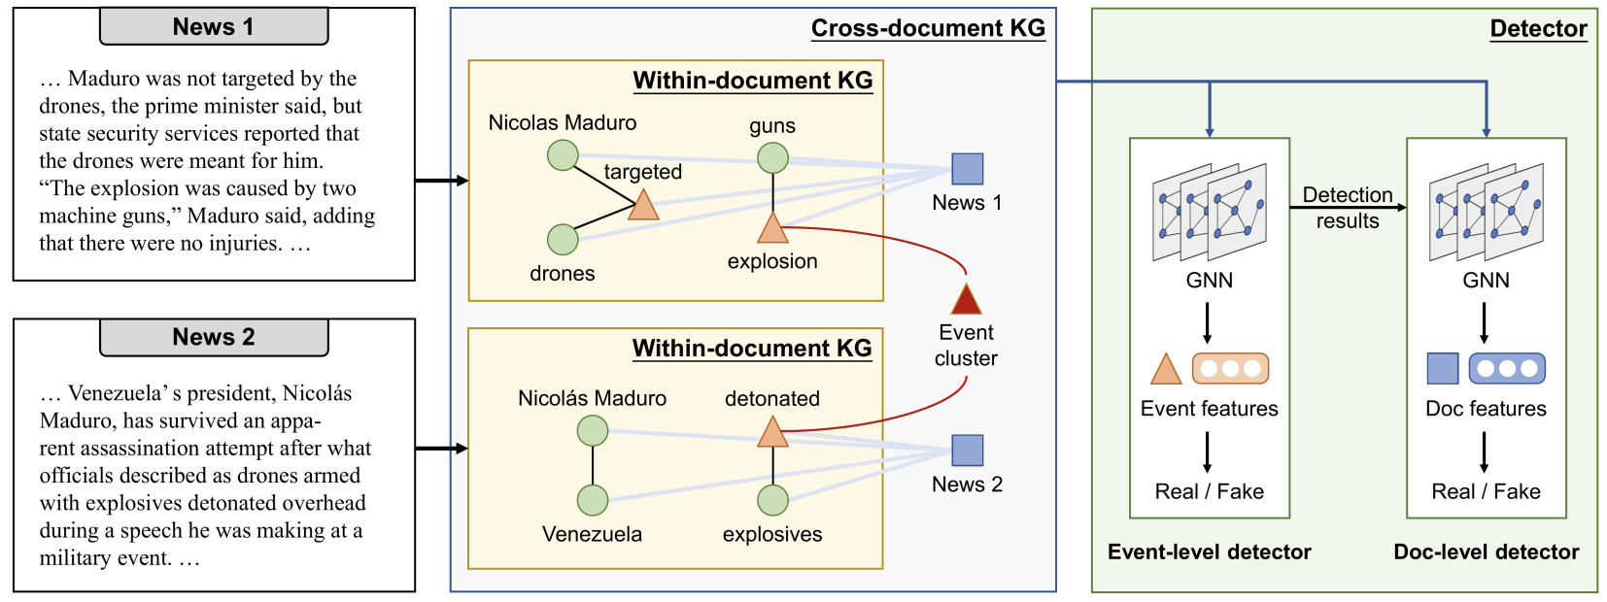
Cross-Document Semantic Consistency Detection
Pros:
Connect knowledge elements across documents via event cluster
Detect for potential inconsistencies in the information about the event clusters, across different documents
Leverage these features to help guide document-level fake news detection as well
Wu, X. and Huang, K. and Fung, Y.R. and Ji, H. Cross-document Misinformation Detection based on Event Graph Reasoning. Proceedings of the 2022 Conference of the North American Chapter of the Association for Computational Linguistics: Human Language Technologies (NAACL22).

Slide 81
Cross-Document Semantic Consistency Detection
Points for Improvement:
This paper made assumption of a pre-existing clusters of new to perform this cross-documents detection, crawled from Wikipedia
For real-world applicability, it is important to explore whether such approach performs well for automatically derived noisy document clusters
Wu, X. and Huang, K. and Fung, Y.R. and Ji, H. Cross-document Misinformation Detection based on Event Graph Reasoning. Proceedings of the 2022 Conference of the North American Chapter of the Association for Computational Linguistics: Human Language Technologies (NAACL22).

Slide 83
Categorization of Semantic Consistency-based Fake News Detection
Semantic Consistency for Fake News Detection
Within-Document
Multi-Media
Est’d Background Knowledge
Context Awareness
Attention-Guided
Cross-Modal Interaction
Textual Knowledge
Cross-Doc
News Cluster
CLIP encoders
Structural Knowledge
Reader
Comments
IE/AMR graph reasoning
Heterogeneous
Representation
Propagation Pattern
Multi-Frame Pooling for Videos
Entity/Event/
Claim Level Linking
User Preference

Slide 84
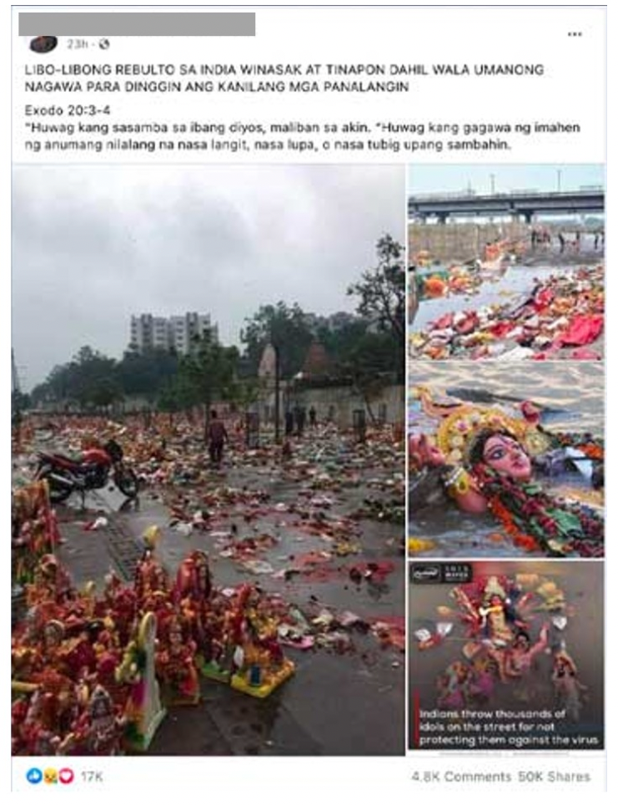
Cross-Media Misinformation Problem: De-Contextualization
Contents are real, but mismatched from the appropriate context
Ex:
The photo was taken in a Hindu religious celebration festival
The news post falsely claims that Indians were frustrated with COVID-19, and throwing away religious figures for failing to protect them against the virus
Huang, M and Jia, S. and Chang M.C. and Lyu, S. Text-Image De-Contextualization Detection Using Vision-Language Models. Proceedings of the 30th ACM International Conference on Information and Knowledge Management (ICASSP’22),

Slide 85
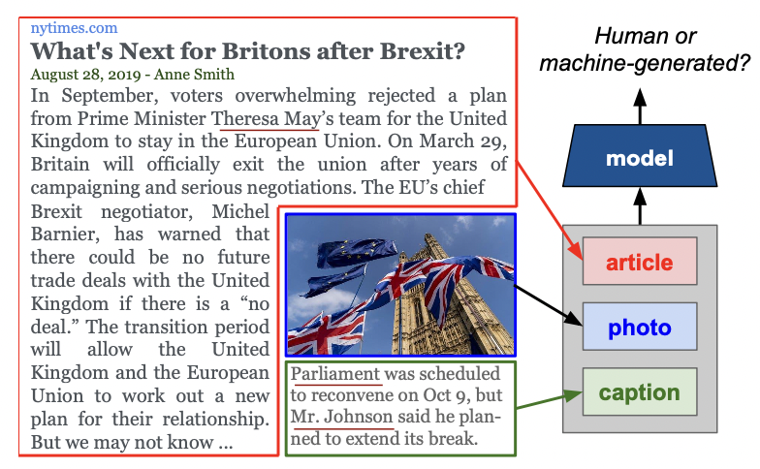
Cross-Media Misinformation Problem: Semantic Gaps or Inconsistency
Semantic gaps or inconsistency may be particularly apparent in sloppy journalism or cases when parts of the text, image or video are fabricated from a fake news
generator model.
Ex:
Main text body talks about Brexit from the European Union.
Caption appears to talk about internal affairs of the British Parliament instead (unrelated).
Tan, R and Plummer, B and Saenko, K. Detecting Cross-Modal Inconsistency to Defend Against Neural Fake News. Proceedings of the 30th ACM International Conference on Information and Knowledge Management (EMNLP’20),
Notes:
The news article text body, image, and caption may be conveying unrelated or
conflicting info due to sloppy journalism, clickbait or sensation-arousing
motivation, news generator model
undesired artifact, etc.

Slide 86
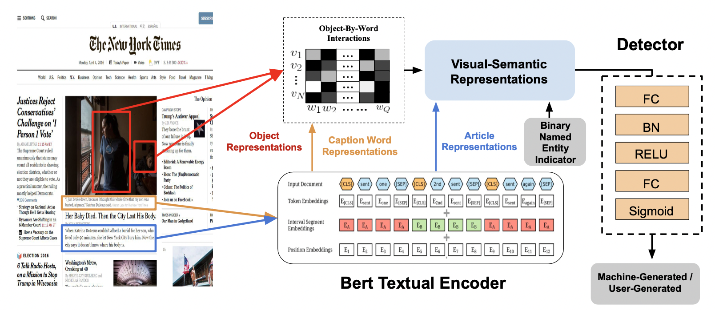
Cross-Media Misinformation Detection: Model Architecture
Design of attention-guided mechanism to capture word-object-interactions
Tan, R and Plummer, B and Saenko, K. Detecting Cross-Modal Inconsistency to Defend Against Neural Fake News. Proceedings of the 30th ACM International Conference on Information and Knowledge Management (EMNLP’20),

Slide 87
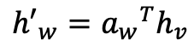
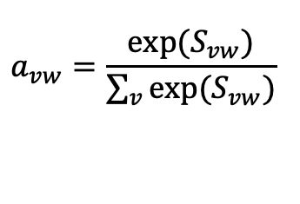
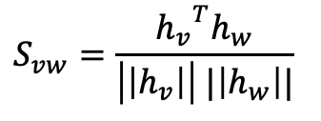
Cross-Media Misinformation Detection: Model Architecture
Design of attention-guided mechanism to capture word-object-interactions
Compute semantic similarity score for every possible object (V) - word (w) pairing
Derive an image-aware text feature vector via:
$$S_{vw}=\frac{{h_{v}}^{T}h_{w}}{\left|\left|h_{v}\right|\right| |\left|h_{w}\right||}$$
$$a_{vw}=\frac{exp⁡(S_{vw})}{\sum_{v}{exp⁡(S_{vw})}}$$
$${h′}_{w}={a_{w}}^{T}h_{v}$$
Tan, R and Plummer, B and Saenko, K. Detecting Cross-Modal Inconsistency to Defend Against Neural Fake News. Proceedings of the 30th ACM International Conference on Information and Knowledge Management (EMNLP’20),

Slide 88
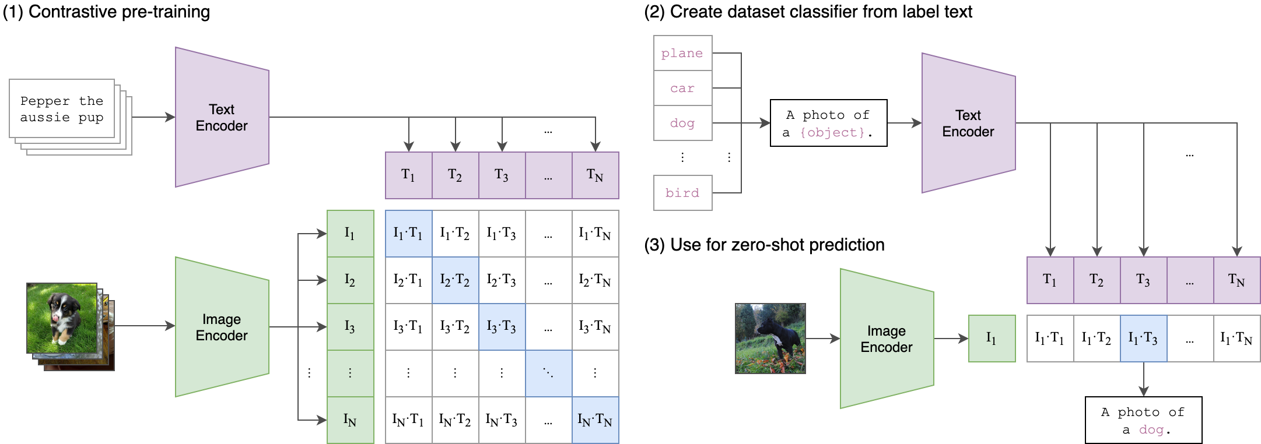
Cross-Media Misinformation Detection: Contrastively Learnt
Besides focusing on the model architecture to capture cross-media misinformation, recent works are also now taking advantage of contrastive learning frameworks, such as CLiP.
Advantage:
Can pre-train from a collection of ultra-large data w/o requiring human annotation
400 million image caption pairs from the open web
Expressive encoders for mapping text and image data to a uniformed semantic space
Radford et al. Learning Transferable Visual Models From Natural Language Supervision. ICML’21.

Slide 89
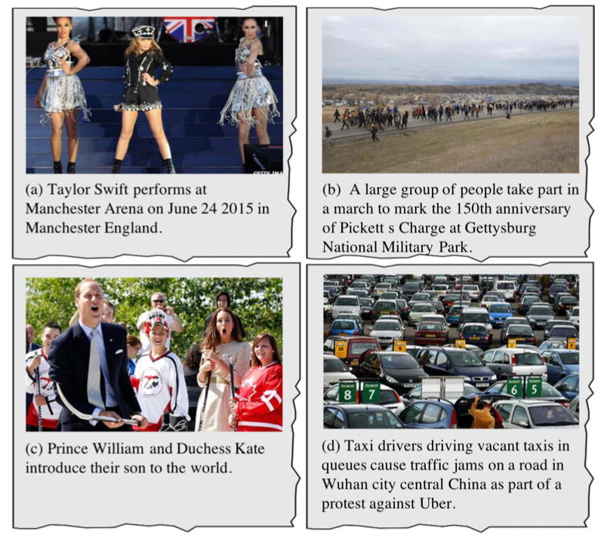
Cross-Media Misinformation Detection: Contrastively Learnt
NewsCLiPpings tailor contrastive framework to the news domain
Introduce strategies for automatically retrieving convincing images, given a news caption
Query for scene
Query for person
Query for semantics
Luo, G. and Darrell, T and Rohrback, A. NewsCLIPpings: Automatic Generation of Out-of-Context Multimodal Media. Proceedings of the 30th ACM International Conference on Information and Knowledge Management (EMNLP’21),
Notes:
introduce several strategies for automati- cally retrieving convincing images for a given caption, capturing cases with inconsistent enti- ties or semantic context.

Slide 90
Cross-Media Misinformation Detection: Contrastively Learnt
The CLiP model can be finetuned to determine image caption mismatch probabilities as well
0.42
Match score
Huang, M and Jia, S. and Chang M.C. and Lyu, S. Text-Image De-Contextualization Detection Using Vision-Language Models. Proceedings of the 30th ACM International Conference on Information and Knowledge Management (ICASSP’22),
Notes:
introduce several strategies for automati- cally retrieving convincing images for a given caption, capturing cases with inconsistent enti- ties or semantic context.

Slide 91
Enhancing Cross-Media Misinformation Detection via Structure
To achieve finer-grained reasoning and misinformation localization, there is also increasing attention on leveraging structured (graph) representation of news content to pinpoint or identify specific misinformative aspects
Ontology
Based
Open
Domain
(most salient info extracted)
(extract a rich and possibly sparse graph representation for versatile info coverage)

Slide 92


Multimedia KG-guided Consistency Reasoning
Combine local and global semantic features
Leverage external knowledge to help pinpoint misinformation
InfoSurgeon
External
Knowledge
Base
bbc.com
Police Brutality in HK at new Extreme Levels
GNN
Aug 11, 2019 Lisa Lu
crowd
Entity Linking
Police brutality has risen to a new, extreme level in HK this past weekend. HK police started shooting
at protestors on the streets, including the unarmed, peaceful protestors. One notable incidence involved a
Head
Nodes
HK
protestors
…
Graph
Classifier
Edge
Classifier
HK police shoot cold bullets at protestors from hidden corners.
police
woman
hidden corner
Real /
Fake
Misinformative
Knowledge
Elements:
woman at the Tsim Sha Tsui bus stop being shot in the eye by a policeman hiding behind corners. No warning was issued beforehand, and the woman was permanently blinded. Local activists are avidly calling for international attention on the HK police brutality.
Tsim Sha Tsui
bus stop
activists
IE / KG Representation
{<police, located in, hidden corner>, <police, blinded, the woman>}
Fung et al. Cross-Media Fine-grained Information Consistency Checking for Fake News Detection. (ACL’21).
Notes:
InfoSurgeon: Cross-Media Fine-grained Information Consistency Checking for Fake News Detection

Slide 93
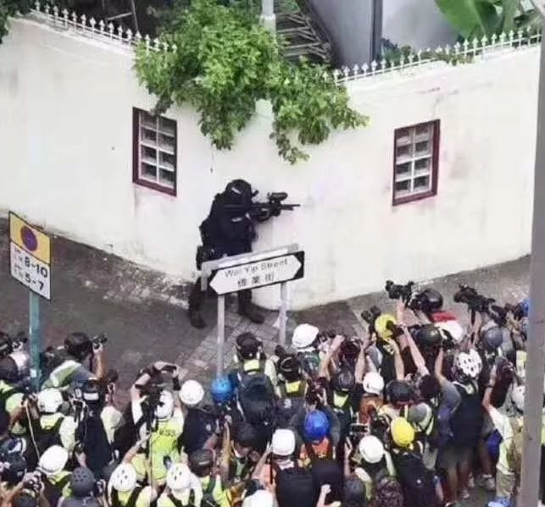

InfoSurgeon checks for Ontology-Guided Information Inconsistencies
Leverages cross-media signals and background knowledge
through feature propagation.
a.) cross-media signals
b.) background knowledge
police
police
✅
“arrest”
Judicial. Arrester
Judicial.Arrestee
surface-form mention embeddings
Physical. LocatedNear
Physical. LocatedNear
✅
feature propagation
“HK”
background
embeddings
“Police”
“protestors”
“hidden corner”
“crowd of people”
Notes:
InfoSurgeon checks for information inconsistency with this merged KG.
It leverages cross-media signals and background knowledge through feature propagation.
For example, a caption that says <police, located near, hidden corner> would conflict with the police shown in the image. But if the caption says
Similarly, we also check for consistency between the surface-form mention embeddings from the news article input and the background knowledge embeddings from WikiData.

Slide 94
Enhancing Cross-Media Misinformation Detection via Structure
To achieve finer-grained reasoning and misinformation localization, there is also increasing attention on leveraging structured (graph) representation of news content to pinpoint or identify specific misinformative aspects
Ontology
Based
Open
Domain
(most salient info extracted)
(extract a rich and possibly sparse graph representation for versatile info coverage)

Slide 95
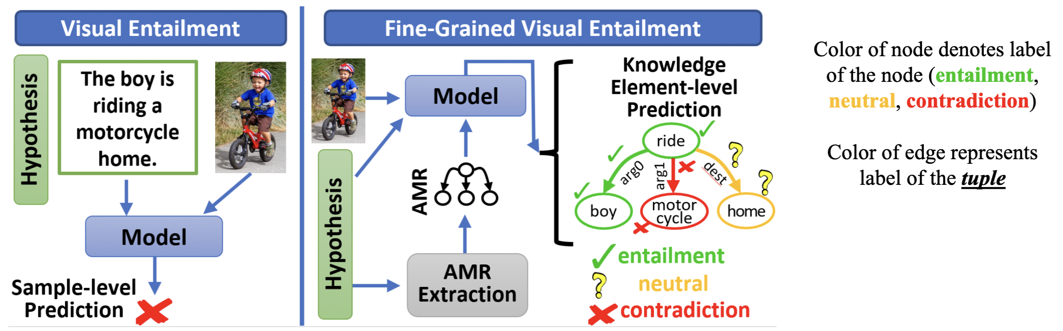
AMR-Guided Visual Entailment for VL Consistency Check: Intuitions
AMR vs IE networks: AMR more versatile in information coverage, not limited to domain-specific ontologies
AMR vs Dependency or Constituency Parsers: AMR is less syntax-dependent and better
Seek to learn a labeling of the AMR graph
Thomas, C and Zhang, Y and Chang, S.F. Fine-Grained Visual Entailment. Proceedings of the 30th ACM International Conference on Information and Knowledge Management (ECCV’22),
Notes:
Seek to learn a labeling of the AMR graph

Slide 96
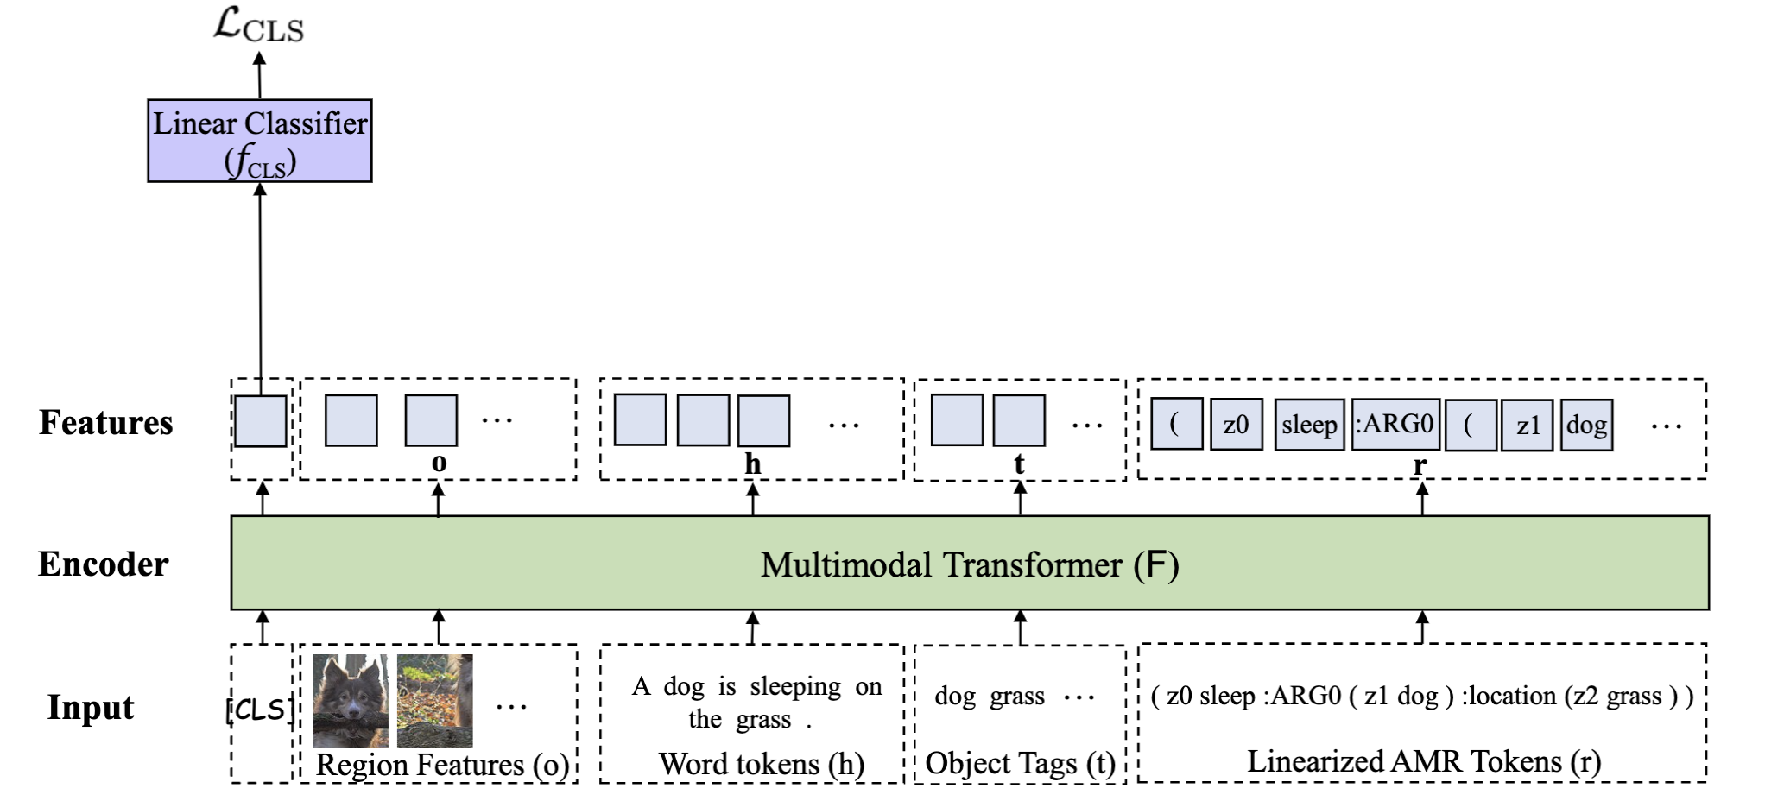
AMR-Guided Visual Entailment for VL Consistency Check
Perform sample level classification using the CLS token
But how to classify the “KE”s in the graph representation?
Thomas, C and Zhang, Y and Chang, S.F. Fine-Grained Visual Entailment. Proceedings of the 30th ACM International Conference on Information and Knowledge Management (ECCV’22),

Slide 97
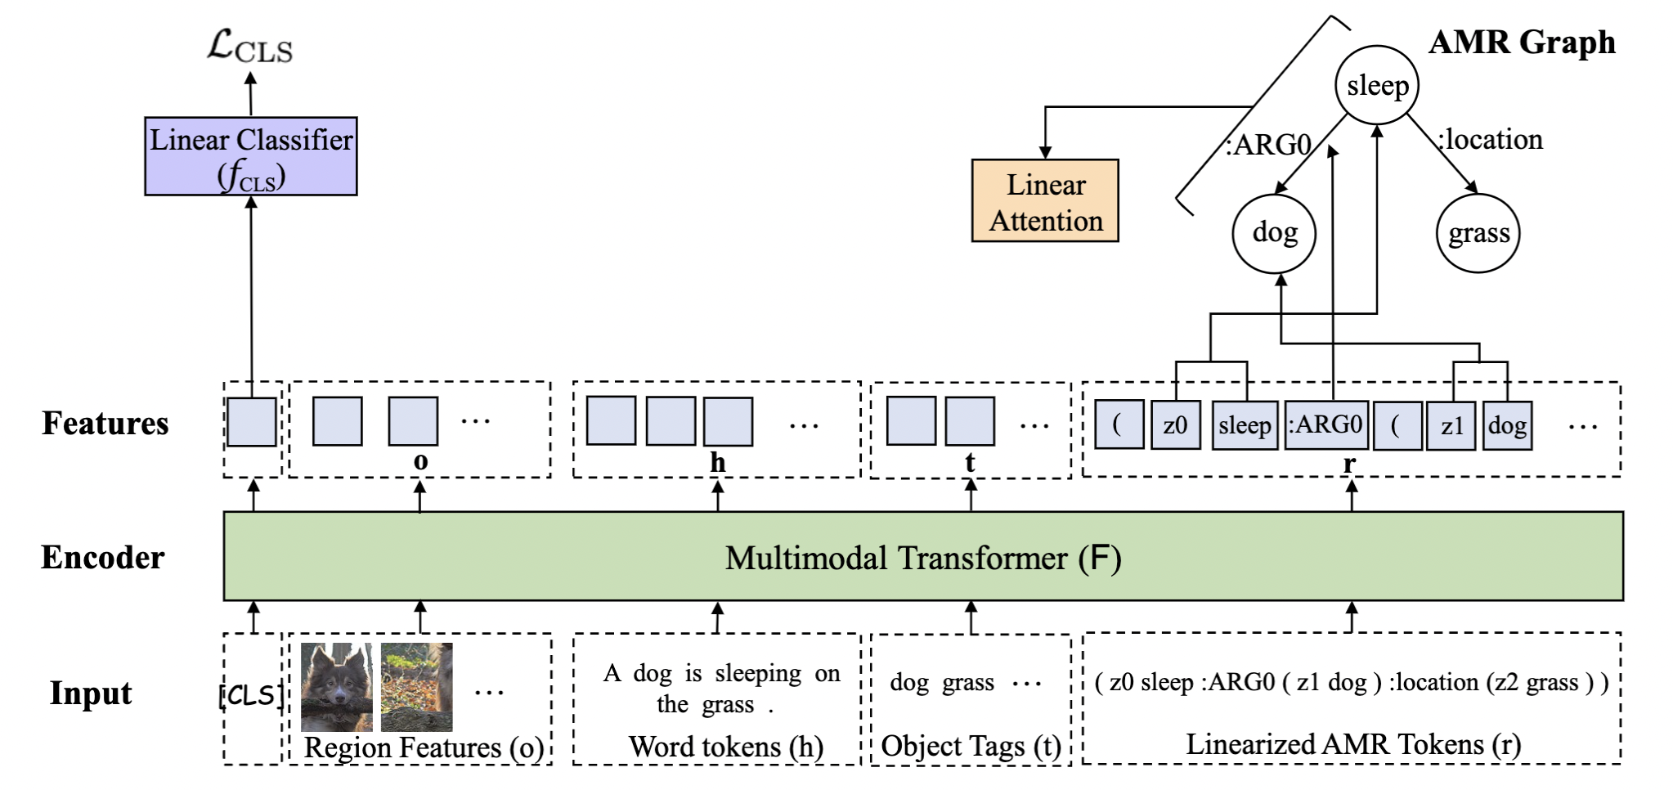
AMR-Guided Visual Entailment for VL Consistency Check
Also perform classification on the AMR “KE”s
Compute an “attention” score for each token
Thomas, C and Zhang, Y and Chang, S.F. Fine-Grained Visual Entailment. Proceedings of the 30th ACM International Conference on Information and Knowledge Management (ECCV’22),

Slide 98
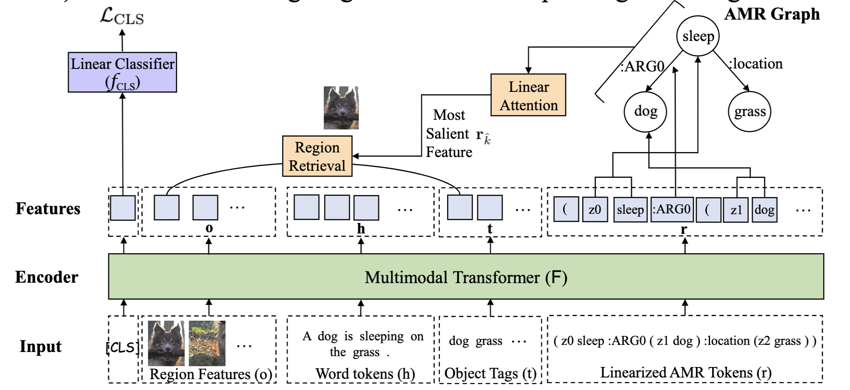
AMR-Guided Visual Entailment for VL Consistency Check
Also perform classification on the AMR “KE”s
Compute an “attention” score for each token
Use token with the highest predicted weight to select the closest tag token
Thomas, C and Zhang, Y and Chang, S.F. Fine-Grained Visual Entailment. Proceedings of the 30th ACM International Conference on Information and Knowledge Management (ECCV’22),

Slide 99
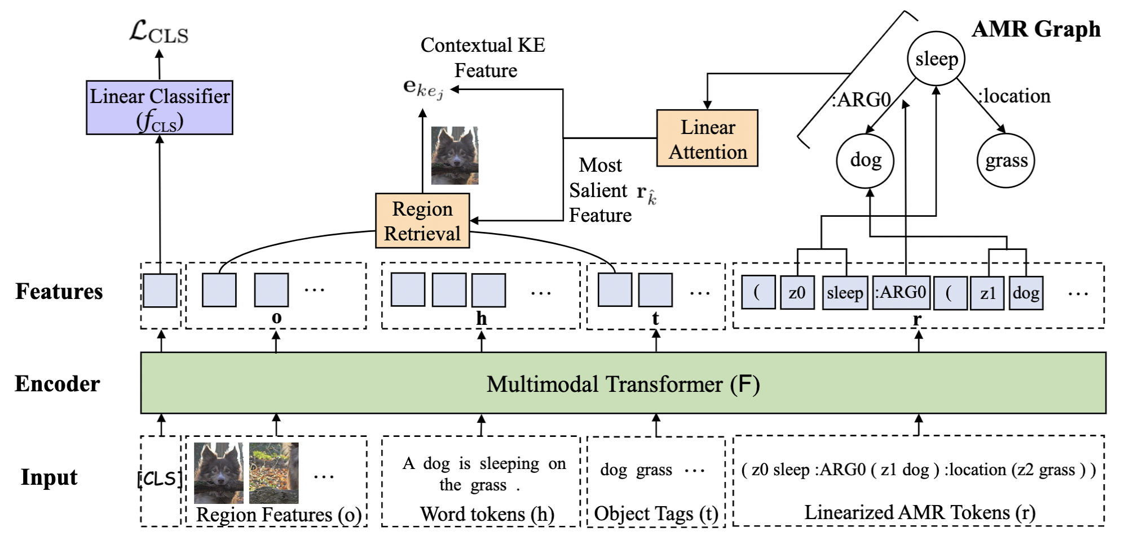
AMR-Guided Visual Entailment for VL Consistency Check
Also perform classification on the AMR “KE”s
Compute an “attention” score for each token
Use token with the highest predicted weight to select the closest tag token
Concat the retrieved image features and a weighted sum of the KE tokens
Thomas, C and Zhang, Y and Chang, S.F. Fine-Grained Visual Entailment. Proceedings of the 30th ACM International Conference on Information and Knowledge Management (ECCV’22),

Slide 100
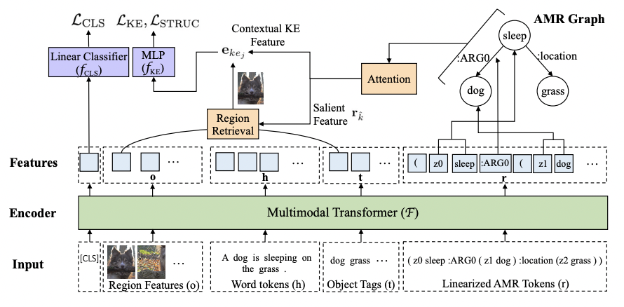
AMR-Guided Visual Entailment for VL Consistency Check
Also perform classification on the AMR “KE”s
Compute an “attention” score for each token
Use token with the highest predicted weight to select the closest tag token
Concat the retrieved image features and a weighted sum of the KE tokens
Feed this per-KE feature into a 3-way MLP classifier
Thomas, C and Zhang, Y and Chang, S.F. Fine-Grained Visual Entailment. Proceedings of the 30th ACM International Conference on Information and Knowledge Management (ECCV’22),

Slide 101
Enhancing Cross-Media Misinformation Detection via Structure
To achieve finer-grained reasoning and misinformation localization, there is also increasing attention on leveraging structured (graph) representation of news content to pinpoint or identify specific misinformative aspects
Ontology
Based
Open
Domain
(most salient info extracted)
(extract a rich and possibly sparse graph representation for versatile info coverage)
Points for Thought: what is the right balance of detail for structured representation in news?

Slide 102
Key Takeaways for Cross-Media Consistency in Fake News Detection
Interesting points:
Cross-media attention-guided mechanisms and contrastive loss have been demonstrated to be effective for modeling cross-media semantic gaps
Leveraging structured news representation (IE, AMR, etc.) helps achieve finer-grained consistency reasoning and misinformation localization
Future Directions:
Extend to more modalities (tables, figures, video and audio)

Slide 103
We Have Now Covered the Main Categories of Semantic Consistency-based Fake News Detection
Semantic Consistency for Fake News Detection
Within-Document
Multi-Media
Est’d Background Knowledge
Context Awareness
Attention-Guided
Cross-Modal Interaction
Textual Knowledge
Cross-Doc
News Cluster
CLIP encoders
Structural Knowledge
Reader
Comments
IE/AMR graph reasoning
Heterogeneous
Representation
Propagation Pattern
Multi-Frame Pooling for Videos
Entity/Event/
Claim Level Linking
User Preference

Slide 104
In Addition, There is a Trend Towards Greater Robustness in Detection
Task | Description (How It Tackles Robustness)
Robustness across Different Misinformation Genres/Flavors [Lee et al., NAACL’21] | Train on sentence-level NewsBias (BASIL), article-level FakeNews (Webis), tweet-level Rumor (PHEME), and headline-level ClickBait binary detection datasets. Then, evaluate model few-shot performance on Propaganda, PolitiFact, and BuzzFeed datasets.
Robustness across News Topics [Biamby et al., AAAI’22] | Different topic domains contain a different distribution of words which may affect fake news detector generalizability Train & evaluate model on Twitter-COMMs: a Twitter multimedia post dataset for news related to the Climate, COVID, and military domain
Multilingual News Robustness | Benchmark misinformation detection in FbMuliLingMisinfo, a multilingual dataset covering 38 unique languages. Current models achieve 83% accuracy in this benchmark, compared to 98% on GossipCop and 87% on PolitiFact.
Notes:
Climate, COVID, and Military Multimodal Misinformation. on FbMultiL- ingMisinfo we achieve 83% accuracy compared to 98% on GossipCop and 87% on PolitiFact.

Slide 105
Key Takeaways in Semantic Consistency-based Fake News Detection
Fact checking models typically consists of an evidence retriever and a claim verifier.
Several challenges in fact checking datasets call for solutions:
Unverifiable claims
Assumptions of the existence of relevant evidence
Choice of labels
Dataset biases
Possible future fact checking research directions include:
How to verify claims with under-specified context?
How to mitigate diachronic bias?
How to produce faithful verdict justification/explanation?

Slide 106
Outline
Introduction
Motivating Examples
Human Psychological Foundations on Impact and Effects
Detection
Fact-Checking
Semantic Inconsistency
Characterization
Bias & Framing
Applications &
Future Directions
Problem Definitions and Task Formulations
Social Context and Propagation Patterns
Intent & Agenda
Corrective Actions
Propaganda Techniques
Remaining Challenges
Future Directions
The Frontier in
Detection & Characterization
Methodologies
(Recent Trends, Pros & Cons, etc.)
Problem Definitions & Task Formulations
Remediative
Applications
& Directions
Fighting Fake
and/or
Biased News
Notes:
Nowadays, the practice of journalism often distributes news content via multimedia.

Slide 107
Outline of Misinformation Characterization Work
Authorship Attribution
Stance and Bias Detection
Propaganda Detection
Framing and Agenda Detection
Moral Value Detection
Propagation Pattern Modeling
Response Prediction
Notes:
Constructing unified, structured knowledge networks by integrating text, social media and multi-genre networks with low cost, high quality and wide coverage
Combining distributional semantics and symbolic semantics through zero-shot transfer learning to construct multi-genre knowledge networks on the fly

Slide 108
Characterizing Intent/Motif behind Misinformation
Notes:
Constructing unified, structured knowledge networks by integrating text, social media and multi-genre networks with low cost, high quality and wide coverage
Combining distributional semantics and symbolic semantics through zero-shot transfer learning to construct multi-genre knowledge networks on the fly

Slide 109
General Work on Authorship Attribution
Goal: identifying the author of an anonymous text, or text whose authorship is in doubt [Love, 2002]
Early efforts
Ngram features [Peng et al., 2003]
Frame semantics enhance author attribution for both translated and untranslated texts [Hedegaard and Simonsen, 2011]
Projects authors and documents to two disjoint topic spaces and uses topic modeling for attribution [Seroussi et al., 2014]
Syntax may be helpful for cross-genre attribution while cross-topic attribution and single-domainmay benefit from additional lexical information [Sundararajan and Woodard, 2018]
Neural methods
Linguistic features are beneficial to further enhance neural language modeling baseline; the top stylistic features are word count, article, period, word-per-sentence count, auxiliary verb, preposition, comma [Uchendu et al., 2020]
Better performance can be achieved by taking the data characteristic into account on choosing authorship attribution features; style features does not always improve results [Sari et al., 2018]
Syntactic parsing tree grounded word embedding brings significant gains to attribution accuracy by augmenting CNN [Zhang et al., 2018]
Notes:
Constructing unified, structured knowledge networks by integrating text, social media and multi-genre networks with low cost, high quality and wide coverage
Combining distributional semantics and symbolic semantics through zero-shot transfer learning to construct multi-genre knowledge networks on the fly

Slide 110
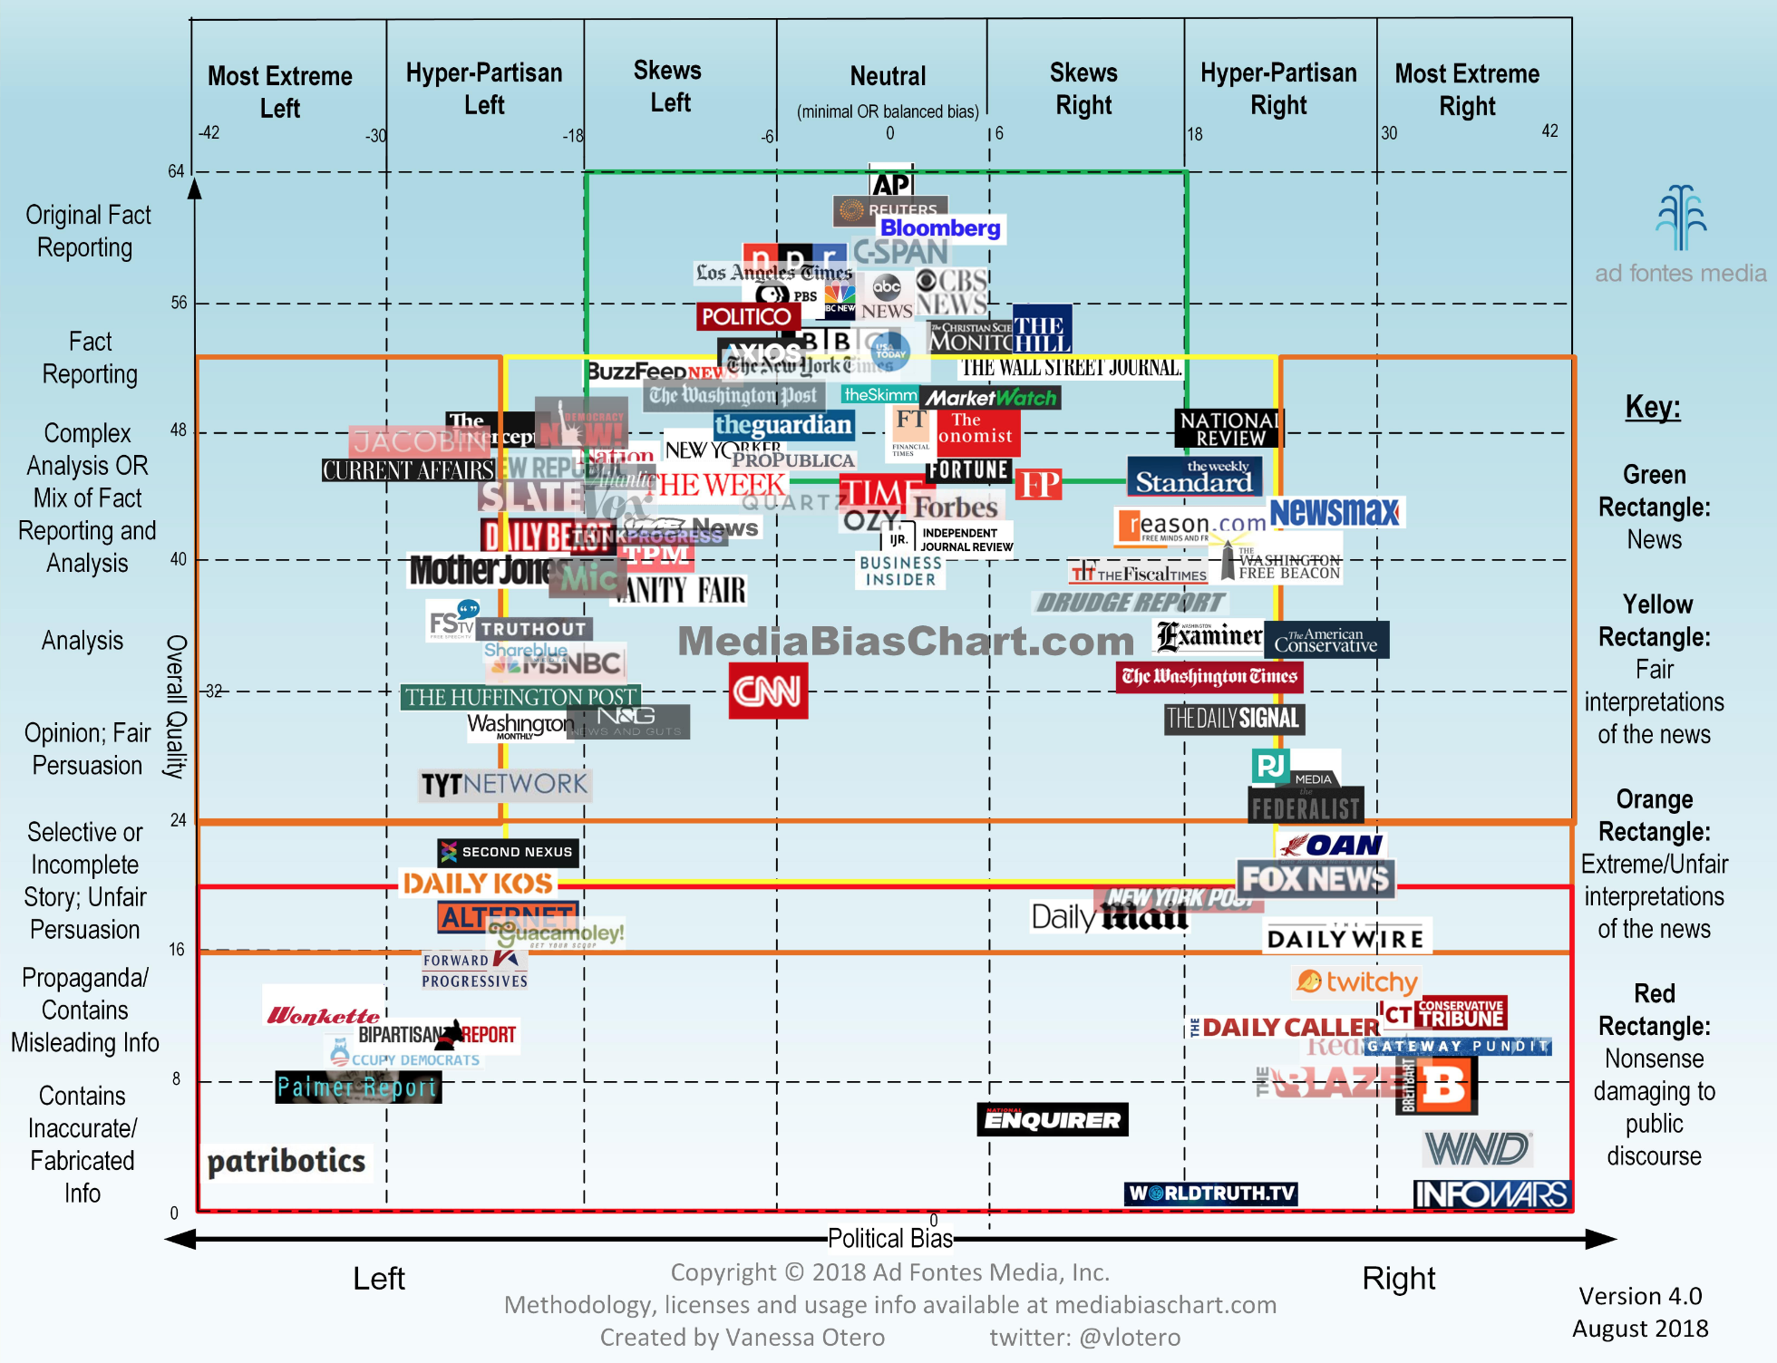
110

Slide 111
https://mediabiasfactcheck.com/
111
Ramy Baly, Georgi Karadzhov, Jisun An, Haewoon Kwak, Yoan Dinkov, Ahmed Ali, James R. Glass, Preslav Nakov:
What Was Written vs. Who Read It: News Media Profiling Using Text Analysis and Social Media Context. ACL 2020: 3364-3374
Notes:
Ablation Study results in the Appendix

Slide 112
112
Ramy Baly, Georgi Karadzhov, Jisun An, Haewoon Kwak, Yoan Dinkov, Ahmed Ali, James R. Glass, Preslav Nakov:
What Was Written vs. Who Read It: News Media Profiling Using Text Analysis and Social Media Context. ACL 2020: 3364-3374

Slide 113
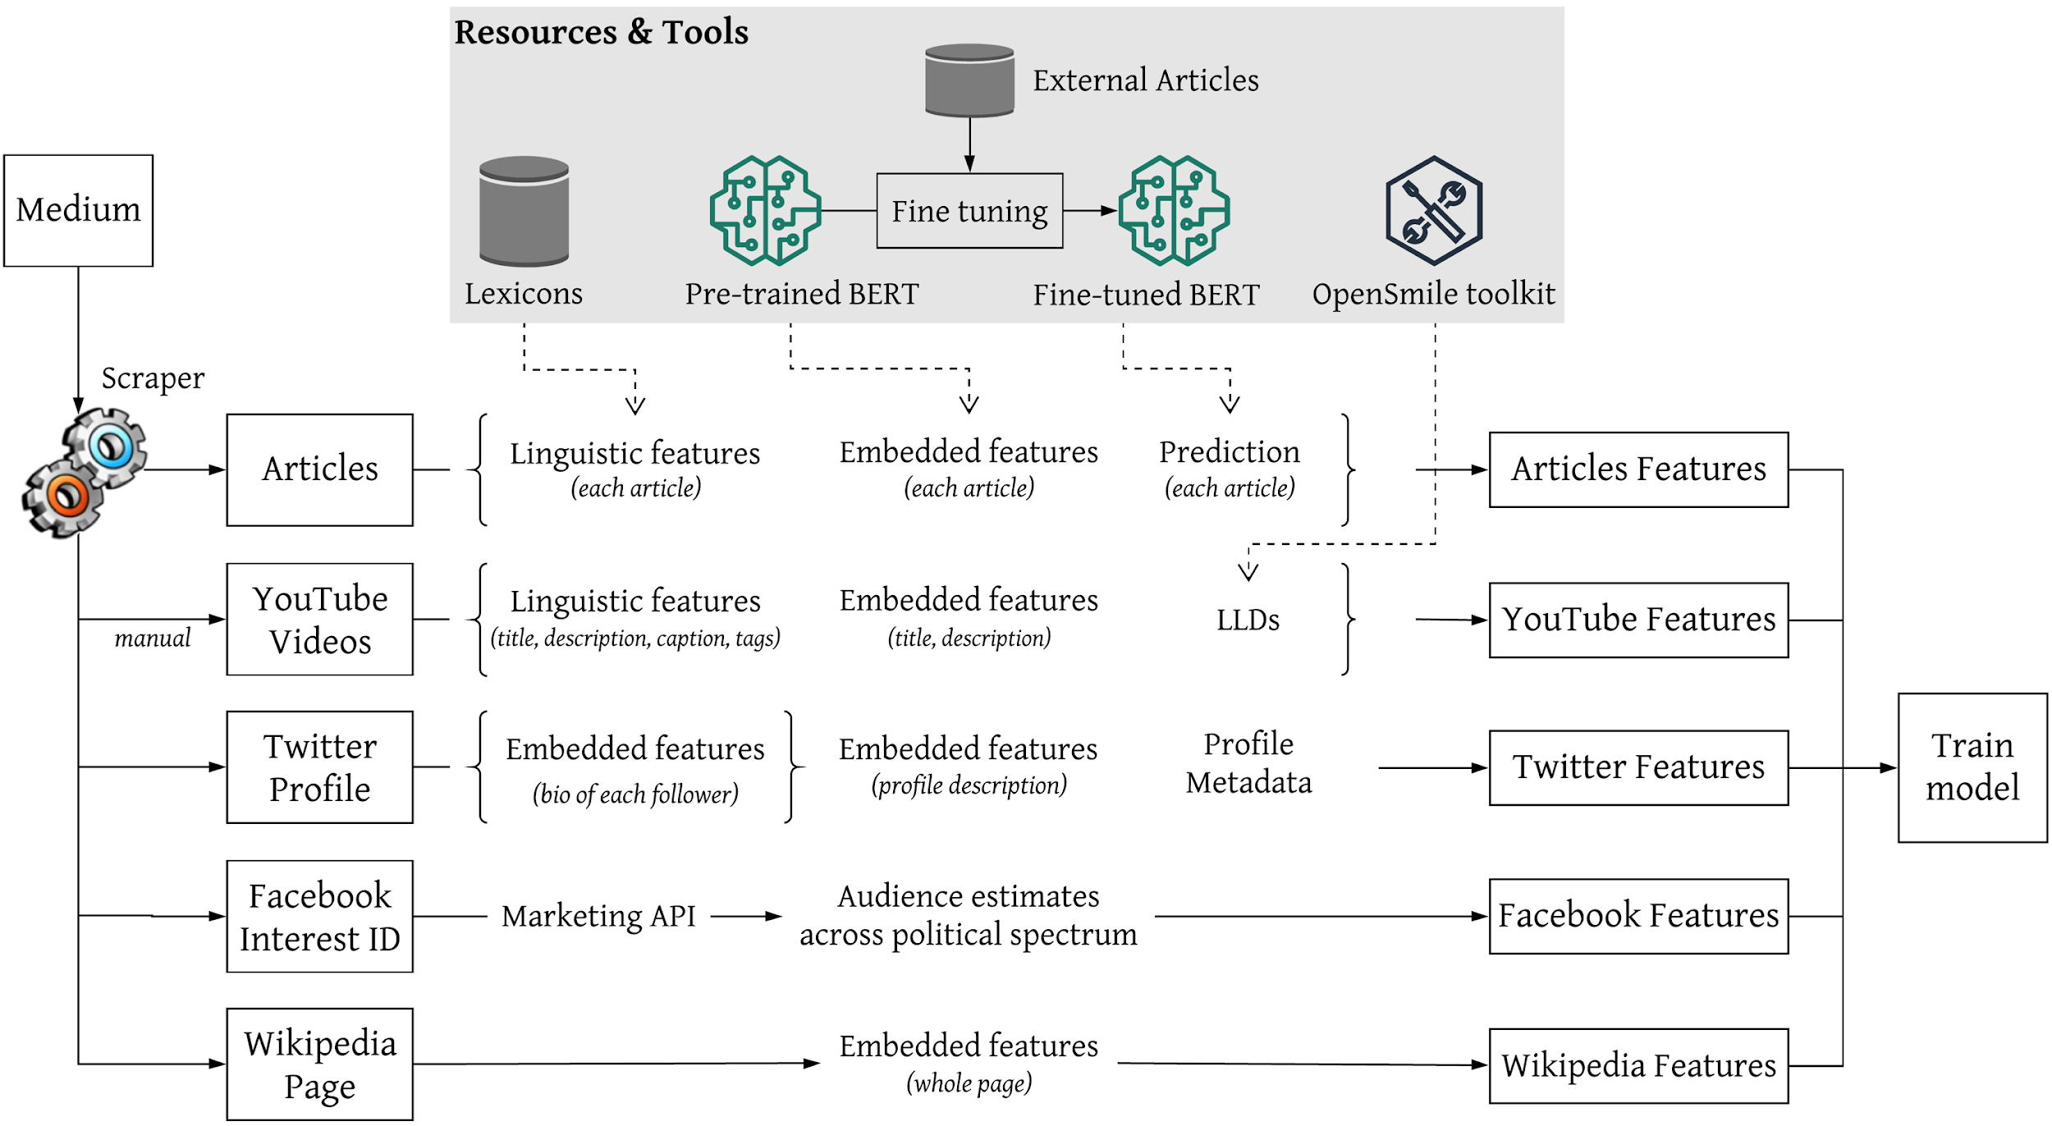
113
Ramy Baly, Georgi Karadzhov, Jisun An, Haewoon Kwak, Yoan Dinkov, Ahmed Ali, James R. Glass, Preslav Nakov:
What Was Written vs. Who Read It: News Media Profiling Using Text Analysis and Social Media Context. ACL 2020: 3364-3374

Slide 114
Stance Detection [Hanselowski et al., COLING18]
Notes:
Constructing unified, structured knowledge networks by integrating text, social media and multi-genre networks with low cost, high quality and wide coverage
Combining distributional semantics and symbolic semantics through zero-shot transfer learning to construct multi-genre knowledge networks on the fly

Slide 115
Stance Detection Features
Baseline Features
The cooccurrence (COOC) of word and character n-grams in the headline and the document as well as two lexicon-based features, which count the number of refuting (REFU) and polarity (POLA) words based on small word lists
Lexical and Topical Features
Bag-of-words (BoW) unigram features
Topic model features based on non-negative matrix factorization (NMF-300, NMF-cos) (Lin, 2007)
Latent Dirichlet Allocation (LDA-cos) (Blei et al., 2001)
Latent Semantic Indexing (LSI-300) (Deerwester et al., 1990)
Two lexicon-based features using NRC Hashtag Sentiment (NRC-Lex) and Sentiment140 (Sent140) (Mohammad et al., 2013)
Word similarity features which measure the cosine similarity of pre-trained word2vec embeddings of nouns and verbs in the headlines and the documents (WSim)
Notes:
Constructing unified, structured knowledge networks by integrating text, social media and multi-genre networks with low cost, high quality and wide coverage
Combining distributional semantics and symbolic semantics through zero-shot transfer learning to construct multi-genre knowledge networks on the fly

Slide 116
Stance Detection Features
Novel Features
Bag-of-character 3-grams (BoC) represent subword information
Structural features (STRUC) include the average word lengths of the headline and the document, the number of paragraphs in the document and their average lengths
Readability features (READ) which estimate the complexity of a text: Less complex texts could be indicative of deficiently written fake news
Headline and document as a concatenated feature vector: SMOG grade (Mc Laughlin, 1969), Flesch-Kincaid grade level and Flesch reading ease (Kincaid et al., 1975), Gunning fog index (Štajner et al., 2012), Coleman-Liau index (Mari and Ta Lin, 1975), automated readability index (Senter and Smith, 1967), LIX and RIX (Jonathan, 1983), McAlpine EFLAW Readability Score (McAlpine, 1997), and Strain Index (Solomon, 2006)
Lexical diversity (LexDiv) metrics, type-token ratio, and the measure of textual diversity (MTLD) (McCarthy, 2005)
Lexicons: MPQA (Wilson et al., 2005), MaxDiff (Kiritchenko et al., 2014), and EmoLex (Mohammad and Turney, 2010)
Notes:
Constructing unified, structured knowledge networks by integrating text, social media and multi-genre networks with low cost, high quality and wide coverage
Combining distributional semantics and symbolic semantics through zero-shot transfer learning to construct multi-genre knowledge networks on the fly

Slide 117
Stance Detection Results
Notes:
Constructing unified, structured knowledge networks by integrating text, social media and multi-genre networks with low cost, high quality and wide coverage
Combining distributional semantics and symbolic semantics through zero-shot transfer learning to construct multi-genre knowledge networks on the fly

Slide 118
Bias Detection [Baly et al., EMNLP18]
Article Features
Structure: POS tags, linguistic features based on the use of specific words (function words, pronouns, etc.), and features for clickbait title classification from (Chakraborty et al., 2016);
Sentiment: sentiment scores using lexicons (Recasens et al., 2013; Mitchell et al., 2013) and systems (Hutto and Gilbert, 2014);
Engagement: number of shares, reactions, and comments on Facebook
Topic: lexicon features to differentiate between science topics and personal concerns;
Complexity: type-token ratio, readability, number of cognitive process words (identifying discrepancy, insight, certainty, etc.);
Bias: features modeling bias using lexicons (Recasens et al., 2013; Mukherjee and Weikum, 2015) and subjectivity as calculated using pre-trained classifiers (Horne et al., 2017);
Morality: features based on the Moral Foundation Theory (Graham et al., 2009) and lexicons (Lin et al., 2017)
Wikipedia Features
Has Page: indicates whether the target medium has a Wikipedia page
Vector representation for each of the following segments of the Wikipedia page, whenever applicable: Content, Infobox, Summary, Categories, and Table of Contents. We generate these representations by averaging the word embeddings (pretrained word2vec embeddings) of the corresponding words
Twitter Features
Has Account: media that publish unreliable information might have no Twitter accounts
Verified, Created, Has Location, Web Traffic
URL Match: Whether the account includes a URL to the medium, and whether it matches the URL we started the search with
Counts: Statistics about the number of friends, statuses, and favorites
Description: A vector representation generated by averaging the Google News embeddings (Mikolov et al., 2013) of all words of the profile description paragraph
Notes:
Constructing unified, structured knowledge networks by integrating text, social media and multi-genre networks with low cost, high quality and wide coverage
Combining distributional semantics and symbolic semantics through zero-shot transfer learning to construct multi-genre knowledge networks on the fly

Slide 119
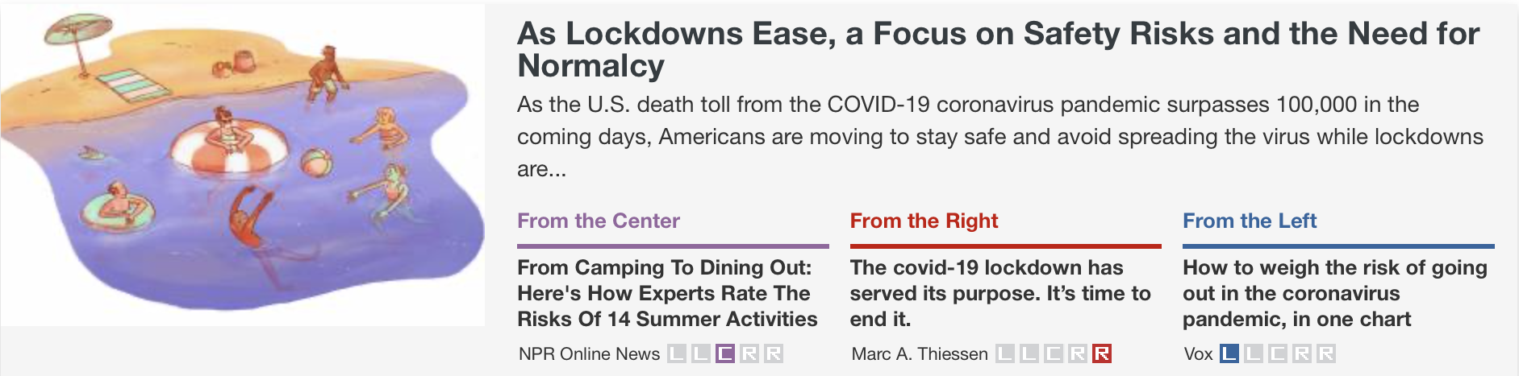
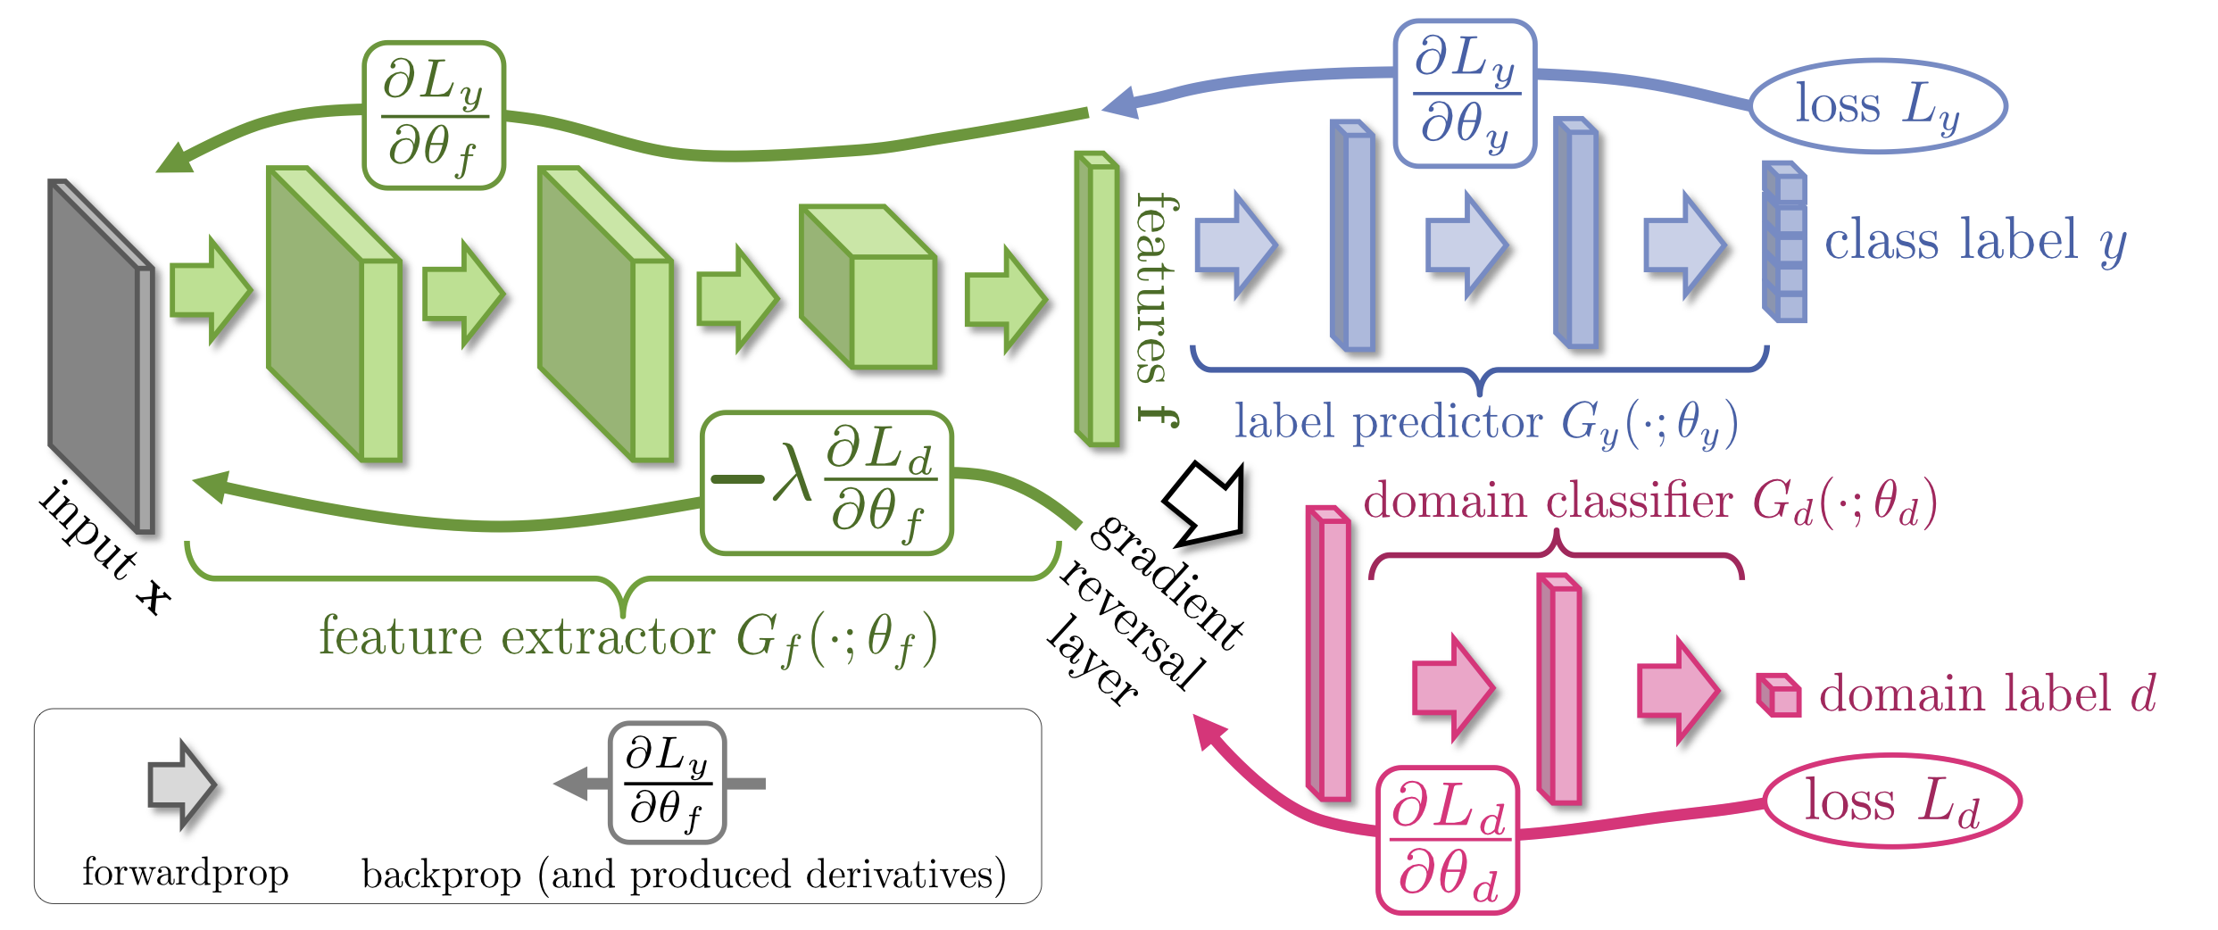
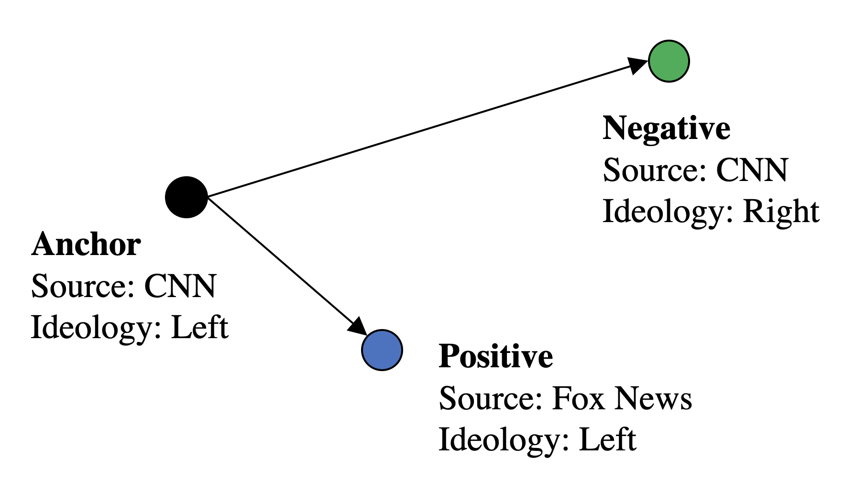
Article-Level Bias Detection
119
Ramy Baly, Giovanni Da San Martino, James Glass, Preslav Nakov:
We Can Detect Your Bias: Predicting the Political Ideology of News Articles. EMNLP-2020

Slide 120
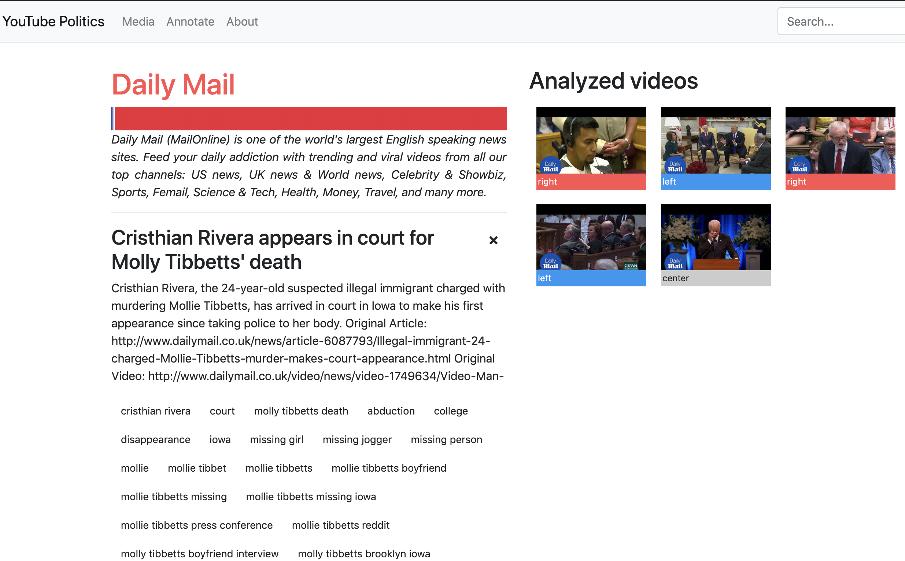
YouTube Channel Bias Detection
120
Yoan Dinkov, Ahmed Ali, Ivan Koychev, Preslav Nakov:
Predicting the Leading Political Ideology of YouTube Channels Using Acoustic, Textual, and Metadata Information. INTERSPEECH 2019

Slide 121

Propaganda: Definition
Propaganda is a communication tool that is deliberately designed to influence the opinions and the actions of other people in order to achieve a predetermined goal.

Slide 122
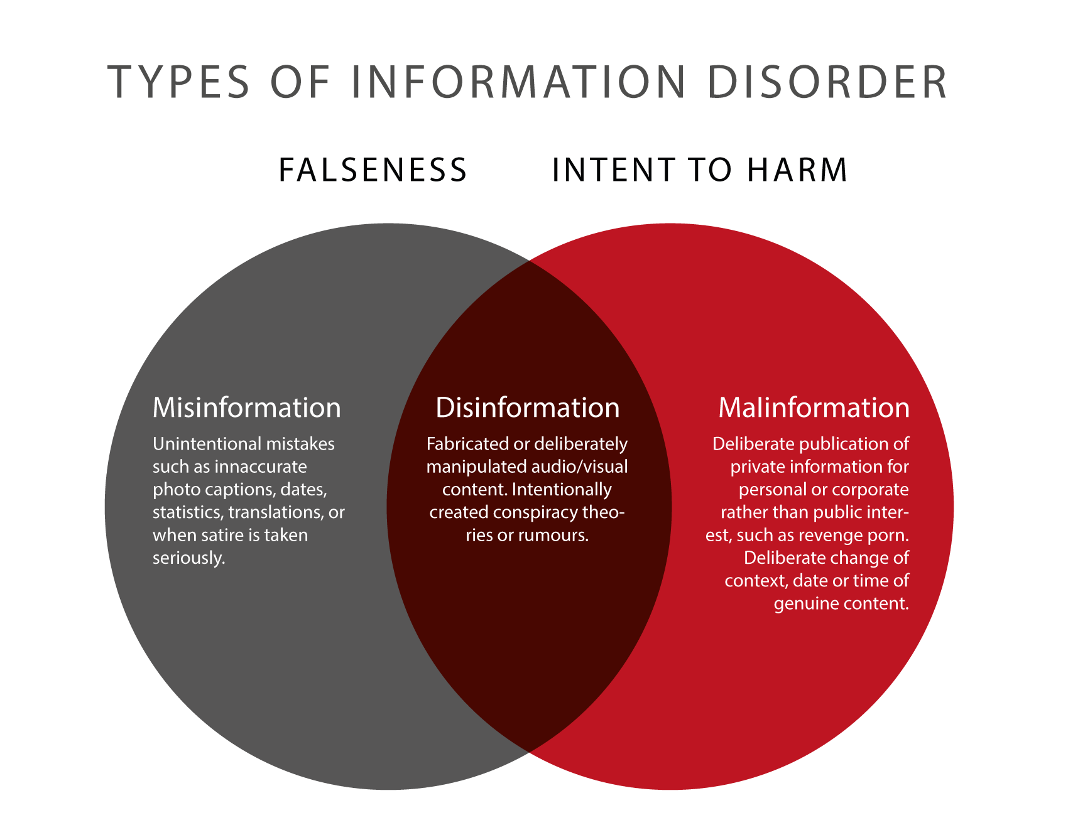
Propaganda is orthogonal to disinformation: can be true/false, harmful/benign.
Around 33% of the human-written fake news use propaganda.
122
Notes:
https://firstdraftnews.org/en/education/curriculum-resource/information-disorder-useful-graphics/; propaganda does not necessarily coincide with malinformation, because the internt might not be to harm

Slide 123
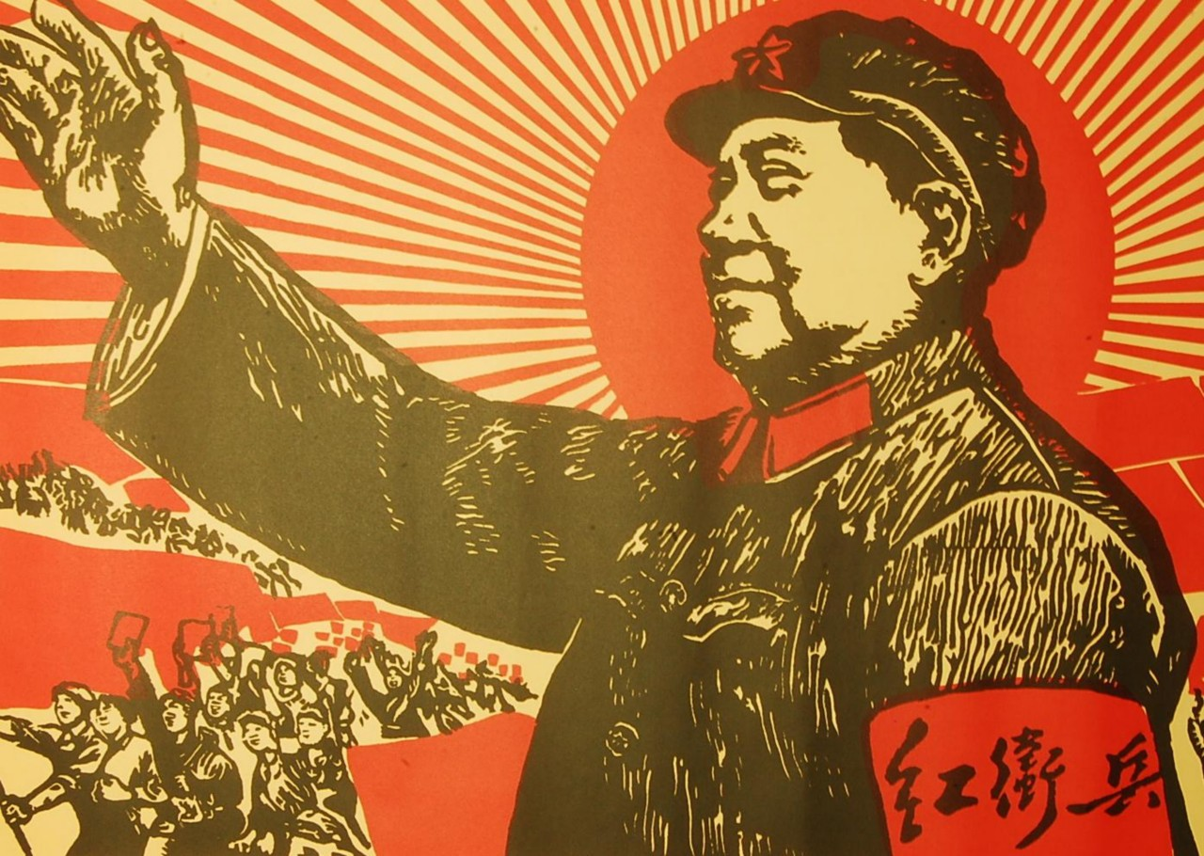



Propaganda: A Historical Perspective
Propaganda campaigns in the pre-Internet era:
Control of the mass media
Closed borders (non-anonymous campaigns)
Require massive resources
Bolsover, G., & Howard, P. (2017). Computational Propaganda and Political Big Data: Moving Toward a More Critical Research Agenda. Big Data, 5(4), 273–276.
123

Slide 124


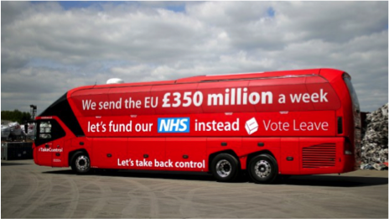
Computational Propaganda
“The rise of the Internet […] has opened the creation and dissemination of propaganda messages, which were once the province of states and large institutions, to a wide variety of individuals and groups.”
Bolsover, G., & Howard, P. (2017). Computational Propaganda and Political Big Data: Moving Toward a More Critical Research Agenda. Big Data, 5(4), 273–276.
124

Slide 125
Computational Propaganda: Technical Considerations
How it is done:
Create persuasive messages that go undetected
Create bots to disseminate the messages
Maximise audience reach
Microprofiling
Monitor the results of the campaigns
125

Slide 126
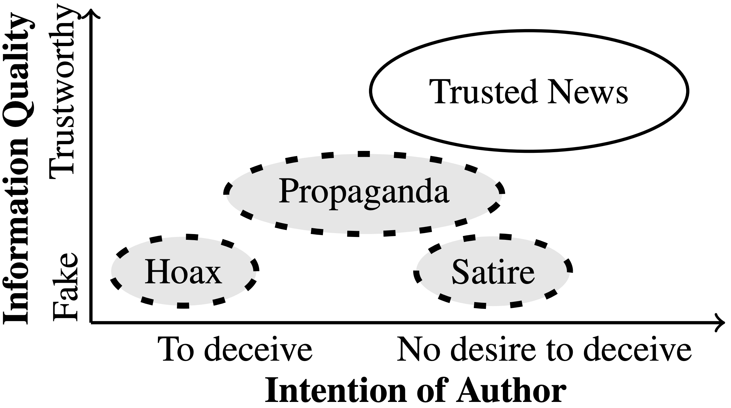
Hannah Rashkin, Eunsol Choi, Jin Yea Jang, Svitlana Volkova, Yejin Choi:
Truth of Varying Shades: Analyzing Language in Fake News and Political Fact-Checking. EMNLP 2017: 2931-2937
126

Slide 127
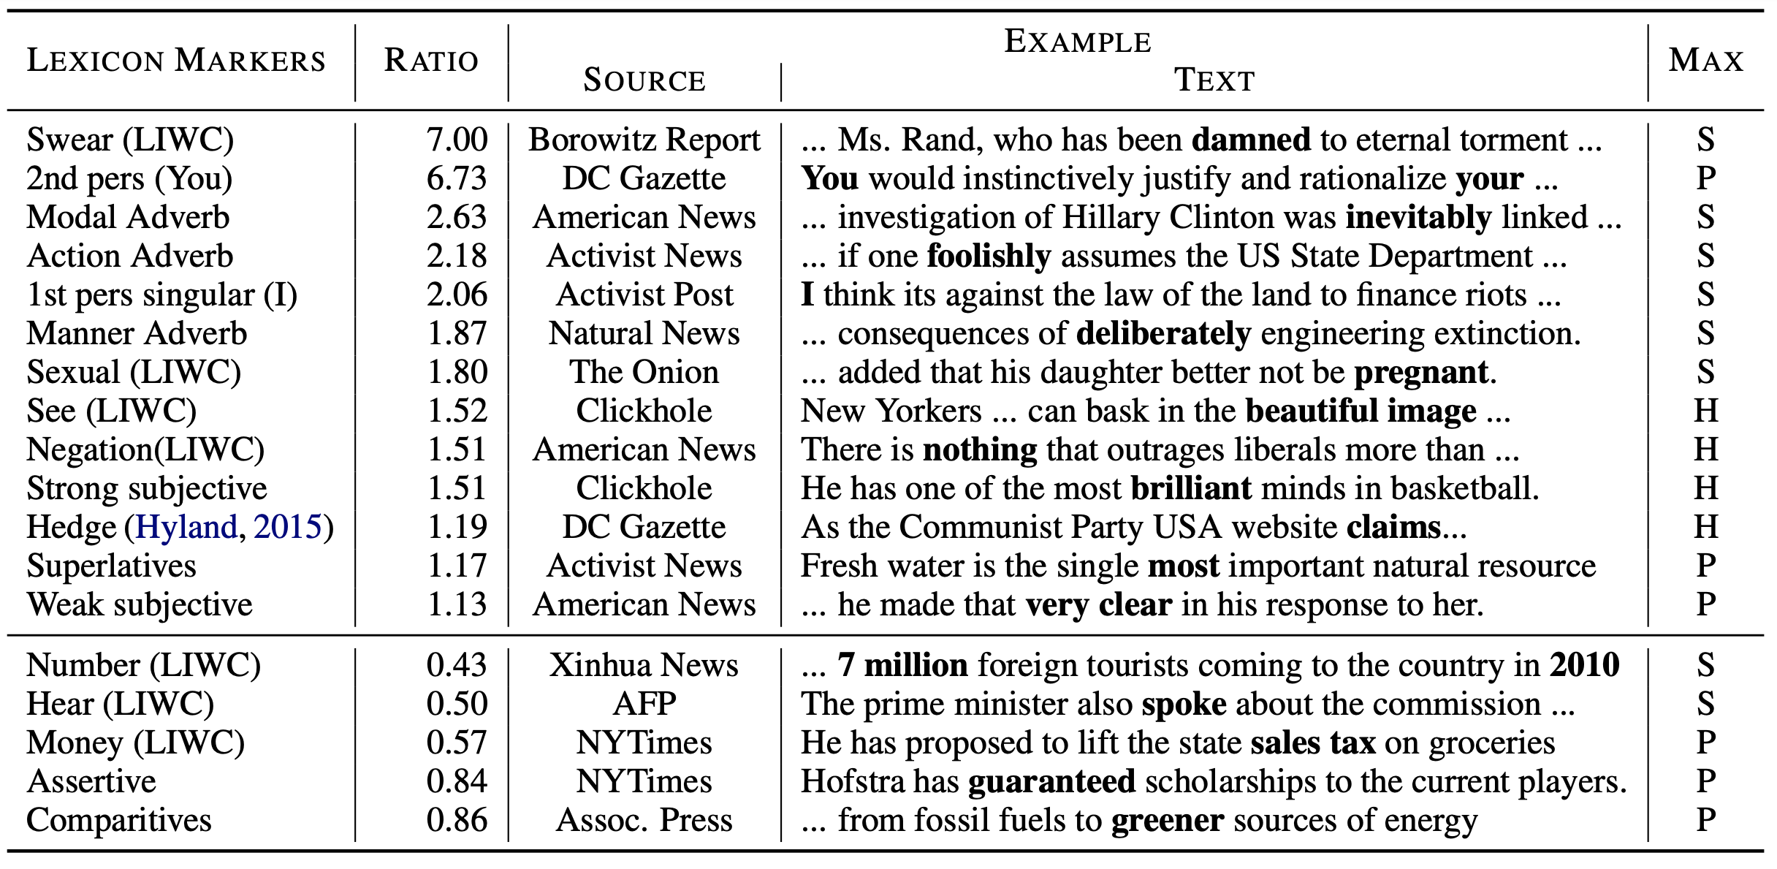
Propaganda vs. Hoax vs. Satire
Hannah Rashkin, Eunsol Choi, Jin Yea Jang, Svitlana Volkova, Yejin Choi:
Truth of Varying Shades: Analyzing Language in Fake News and Political Fact-Checking. EMNLP 2017: 2931-2937
127

Slide 128
Proppy: Detecting Document-Level Propaganda
Word n-grams
Lexical features (LIWC, Wiktionary)
Vocabulary richness features (type token ratio)
Readability features (Flesch-Kincaid grade level, Flesch reading ease)
Style features: (TF-IDF weighted Character 3-grams)
NELA* features (POS counts, bias and subjectivity scores,...)
Alberto Barrón-Cedeño et al.Proppy: Organizing the news based on their propagandistic content.Inf. Process. Manag., 56(5):1849–1864, 2019
*B. Horne, S. Khedr, S. Adal, “Sampling the news producers: A large news and feature data set for the study of the complex media landscape” AAAI-18
128

Slide 129
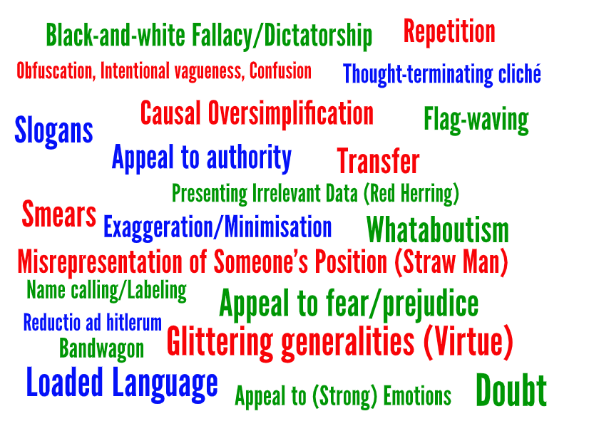
Propaganda Techniques
Emotional appeals
Logical fallacies
Notes:
FA: Could have been better to use number with techniques, then people can understand there are 22 techniques in total.
Then in the next few slides we can more important examples, not all only a few.

Slide 130

Name Calling
IJCAI-2020: A Survey on Computational Propaganda Detection.
Giovanni Da San Martino, Stefano Cresci, Alberto Barrón-Cedeño, Seunghak Yu, Roberto Di Pietro, Preslav Nakov
130

Slide 131

Slogans
IJCAI-2020: A Survey on Computational Propaganda Detection.
Giovanni Da San Martino, Stefano Cresci, Alberto Barrón-Cedeño, Seunghak Yu, Roberto Di Pietro, Preslav Nakov
131

Slide 132

Appeal to Fear
“We are in the middle of the sixth mass extinction, with more than 200 species getting extinct every day."
IJCAI-2020: A Survey on Computational Propaganda Detection.
Giovanni Da San Martino, Stefano Cresci, Alberto Barrón-Cedeño, Seunghak Yu, Roberto Di Pietro, Preslav Nakov
132

Slide 133

Bandwagon
IJCAI-2020: A Survey on Computational Propaganda Detection.
Giovanni Da San Martino, Stefano Cresci, Alberto Barrón-Cedeño, Seunghak Yu, Roberto Di Pietro, Preslav Nakov
133

Slide 134

Propaganda Detection (Gupta et al., 2019)
Notes:
Constructing unified, structured knowledge networks by integrating text, social media and multi-genre networks with low cost, high quality and wide coverage
Combining distributional semantics and symbolic semantics through zero-shot transfer learning to construct multi-genre knowledge networks on the fly

Slide 135

EMNLP-2019: Fine-Grained Analysis of Propaganda in News Articles.
Giovanni Da San Martino, Seunghak Yu, Alberto Barrón-Cedeño, Rostislav Petrov, Preslav Nakov
135

Slide 136


ACL-2020 (best demo award, honorable mention): Prta: A System to Support the Analysis of Propaganda Techniques in the News.
Giovanni Da San Martino, Shaden Shaar, Yifan Zhang, Seunghak Yu, Alberto Barrón-Cedeño, Preslav Nakov
136

Slide 137



Shared Tasks at SemEval: 2019-2021
137

Slide 138


Propaganda in Memes
Why Memes?
easy to understand
can easily spread
ACL-2021 (Findings): Detecting Propaganda Techniques in Memes.
Dimitar Dimitrov, Bishr Bin Ali, Shaden Shaar, Firoj Alam, Fabrizio Silvestri, Hamed Firooz, Preslav Nakov and Giovanni Da San Martino

Slide 139
Propaganda Techniques
Loaded language: “hate”
Name calling: “terrorist”
I HATE TRUMP
MOST TERRORIST DO
SemEval-2021: SemEval-2021 Task 6: Detection of Persuasive Techniques in Texts and Images
Dimitar Dimitrov, Bishr Bin Ali, Shaden Shaar, Firoj Alam, Fabrizio Silvestri, Hamed Firooz, Preslav Nakov and Giovanni Da San Martino

Slide 140

Propaganda Techniques
Loaded language: “hate”
Name calling: “terrorist”
Smears: towards Ilhan Omar
Reductio ad hitlerum: bad people hate Trump, therefore it is a bad thing to hate him
SemEval-2021: SemEval-2021 Task 6: Detection of Persuasive Techniques in Texts and Images
Dimitar Dimitrov, Bishr Bin Ali, Shaden Shaar, Firoj Alam, Fabrizio Silvestri, Hamed Firooz, Preslav Nakov and Giovanni Da San Martino

Slide 141


Propaganda Detection in Memes
Appeal to Fear; Black & White Fallacy
Whataboutism
ACL-2021 (Findings): Detecting Propaganda Techniques in Memes.
Dimitar Dimitrov, Bishr Bin Ali, Shaden Shaar, Firoj Alam, Fabrizio Silvestri, Hamed Firooz, Preslav Nakov and Giovanni Da San Martino
141

Slide 142

Detecting Harmful Memes and Their Targets
Type:
Fake news
Hate speech
Attacks, sarcasm
…
Harmfulmess:
very harmful
partially harmful
harmless
Target:
individual
organization
community/country
society/general public/others
ACL'2021 (Findings): Detecting Harmful Memes and Their Targets.
Shraman Pramanick, Dimitar Dimitrov, Rituparna Mukherjee, Shivam Sharma, Md. Shad Akhtar, Preslav Nakov, Tanmoy Chakraborty
142

Slide 143

Detecting Harmful Memes and Their Targets
EMNLP'2021 (Findings): MOMENTA: A Multimodal Framework for Detecting Harmful Memes and Their Targets
Shraman Pramanick, Shivam Sharma, Dimitar Dimitrov, Md. Shad Akhtar, Preslav Nakov, Tanmoy Chakraborty
143

Slide 144

Detecting the Specific Target of Harmful Memes
Example meme, along with the candidate entities, harmful targets, and non-harmful references.
NAACL-2022: DISARM: Detecting the Victims Targeted by Harmful Memes
Shivam Sharma, Md Shad Akhtar, Preslav Nakov and Tanmoy Chakraborty

Slide 145

Detecting the Specific Target of Harmful Memes
NAACL-2022: DISARM: Detecting the Victims Targeted by Harmful Memes
Shivam Sharma, Md Shad Akhtar, Preslav Nakov and Tanmoy Chakraborty
145

Slide 146
Loaded Language
Propaganda-loaded Training Data Generation for Misinformation Detection
[Huang et al., arxiv2022]
Analyzing the 2K loaded language examples in a propaganda dataset [6], we observe that most of the loaded languages are adjectives describing a noun or adverbs describing a verb.
→ Train a model to generate emotion-triggering adjectives or adverbs.
Two-step generation:
Train a model that learns where to insert a <mask> in a given sentence.
Train another model that fill in the <mask> with an emotion-triggering adjective or adverb.
“He is a politician.”
↓
“He is a <mask> politician.”
↓
“He is a cunning politician.”
[6] Da San Martino, G., Yu, S., Barrón-Cedeño, A., Petrov, R., & Nakov, P. (2019). Fine-Grained Analysis of Propaganda in News Article. EMNLP.

Slide 147

Appeal to Authority
Propaganda-loaded Training Data Generation for Misinformation Detection
Reuse the BART model that we fine-tuned for disinformation generation.
Prompt the decoder with XXX confirms that “, where XXX can be an expert or a public figure.
Sources of authorities:
Famous entities from Wikidata:
Search for famous Decision makers, Economists, Biologists and Immunologists
Use “out degree” of each entity to approximate PageRank.
To ensure recency, keep those who were born after 1940.
Person named entities identified in the context.
Notes:
Insert a mask to inform the model to fill in this mask, but with the constraint that the decoding sequence must start with XXX
Maybe need to come up with a variety of templates.
Challenge: determine the XXX

Slide 148

Results: Human-written Fake News Detection
Detector | Training Data | Accuracy (%)
GROVER-Large | Ours (gold) | 66.8
 | Ours (silver) | 62.1
 | GROVER-generated | 59.5
RoBERTa-Large | Ours (gold) | 66.9
 | Ours (silver) | 61.8
 | GROVER-generated | 54.9

Slide 149
Framing: Heuristic Principles [Cialdini and Garde, 1987]
[Cialdini and Garde, 1987]
Scarcity states that people tend to value an item more as soon as it becomes rare, distinct or limited
Emotion says that making messages full of emotional valence andarousal affect (e.g., describing a miserablesituation or a happy moment) can make people care and act
Commitment states that once we make a choice, we will encounter pressures that cause us to respond in ways that justify our earlier decision, and to convince others that we have made the correct choice
Concreteness refers to providing concrete facts or evidence
[Yang et al., 2019]
Impact and Value emphasizes the importance or bigger impact
149
Notes:
Change low resource IL to a language which is not in wikipedia
Word-level: from bi-lingual dicts and alignment; structure-level comes from wals; multi-level alignment

Slide 150

Entity-Centric Framing [Ziems and Yang, 2021]
Entity-centric Frames
Age, Gender, and Race
Armed or Unarmed
Attacking or Fleeing
Criminality
Mental Illness
Issue Frames
Legal Language
Official and Unofficial Sources
Systemic
Video
Moral Foundations
Linguistic Style
Passive Construction
Modal Verbs
Possible Improvements
Extend to other domains
Incorporate discourse-level structure features (e.g., event narratives)
150
Notes:
Change low resource IL to a language which is not in wikipedia
Word-level: from bi-lingual dicts and alignment; structure-level comes from wals; multi-level alignment

Slide 151


Framing: Ordering of Rhetorical Strategies [Shaikh et al., 2020]
Common Persuasive Patterns
“Please sir, I want some more.”
“It’s My Money & I Need It Now. “
Possible Improvements: explicitly model how events and topics evolve over time
151
Notes:
Change low resource IL to a language which is not in wikipedia
Word-level: from bi-lingual dicts and alignment; structure-level comes from wals; multi-level alignment

Slide 152





Moral Foundations Theory
Moral Foundations Theory (MFT; Haidt & Joseph, 2004; Graham et al., 2013):
Five psychological systems or intuitions account for various aspects of morality
Serve different but related social functions
Degree of sensitivity towards them vary across different cultures and context
Are innate but the sensitivity towards them can change over time
The five Foundations (each covering both virtues and vices):
Care
Harm
Fairness
Cheating
Loyalty
Betrayal
Authority
Subversion
Purity
Degradation
Notes:
Caring and protecting individuals from harm.
Concerns regarding acts of cooperation, reciprocity and cheating
patriotism, self-sacrifice, etc. as well as their vice counterparts such as betrayal and unfaithfulness
Concerns regarding respect and insubordination.
Sanctity disgust, degradation, and pollution

Slide 153


Moral Value Detection [Lin et al., 2018]
Overall framework.
For better text understanding, we use a Recurrent Neural Network-based classifier with long shot-term memory units.
We train a separate classifier for each foundation and merge classification results from all classifiers.
Notes:
Some recent in vivo tasks are shown here.
Ratinov and Roth used d2w output to aid coreference resolution.
For example, knowing that kursk can be a vessel helps link kursk to vessel.
WP concepts present in a document help to make document similarity calculation more robust.
Also, WP concepts are rich with information including coarse and fine grained properties that can shed light on,
for example, a users intent during query formulation.

Slide 154

Applications: Predicting the Degree of Violence in Protests
(Mooijman et al., Nature Human Behavior 2018, June Cover)

Slide 155

Applications: County-Level Moral Concerns
(Mooijman et al., Nature Human Behavior 2018, June Cover)

Slide 156

Applications: Ukraine Event and Moral Value Map
http://162.243.120.148:8080/

Slide 157
Outline
Introduction
Motivating Examples
Human Psychological Foundations on Impact and Effects
Detection
Fact-Checking
Semantic Inconsistency
Characterization
Bias & Framing
Applications &
Future Directions
Problem Definitions and Task Formulations
Social Context and Propagation Patterns
Intent & Agenda
Corrective Actions
Propaganda Techniques
Remaining Challenges
Future Directions
The Frontier in
Detection & Characterization
Methodologies
(Recent Trends, Pros & Cons, etc.)
Problem Definitions & Task Formulations
Remediative
Applications
& Directions
Fighting Fake
and/or
Biased News
Notes:
Nowadays, the practice of journalism often distributes news content via multimedia.

Slide 158

Future Direction: Information Correction
Information Surgery
Misinformative Text
Bruno Mars’ "Bad Boys" soundtrack will be released on February 5.
On February 4, the Red Hot Chili Peppers will kick off their North American tour with a concert in East Rutherford, New Jersey. The band will be followed by performances in Chicago, Grand Rapids, Michigan, and Las Vegas. R&B singer Carrie Underwood will be inducted into the Rock and Roll Hall of Fame on February 6. The ceremony will be held in New York City. Carrie will be the first female inductee into the Hall. Other inductees include Beyonce, Band Perry, Phillip Phillips, Queen Latifah, Vince Neil, Nikki Sixx, Mick Mars, Alice Cooper and Chantel Jeffries…
Lady Gaga has been released from jail in Miami after posting bail. She was charged with possession of marijuana and possession of drug paraphernalia. She is scheduled to appear on the February 4 episode of "American Idol.” … Susan Ryan and her husband, Jim, will take their fans to the historic Strawberry Fields in Central Park in Orlando, Florida, on February 8. The site was named in honor of …
With InfoSurgeon, we can detect the misinformative claims from fake news (e.g. Lady Gaga arrested), and remove them to regenerate good news articles.
Misinformative KG
<Bruno Mars> <Motley Crue> <NFL> <MetLife Stadium> <Red Hot Chili Peppers> <Beyonce> <Band Perry> <Phillip Phillips> <Jersey Boys> <Renee Fleming> <Lady Gaga,Justice.ArrestJailDetain.ArrestJailDetain _Detainee-ArrestJailDetain_Place, Dade County> ... <Susan Ryan,Movement.TransportArtifact_Transporter-TransportArtifact_Destination, Strawberry Fields>...<John Williams, Personnel.StartPosition_Employee, ...
Regenerated Text from Repaired KG
Bruno Mars’ "Bad Boys" album debuts at Number One on the Billboard 200 chart this week with its first week of sales. The album sold more than 100,000 copies in its first three weeks of release. Other Top 10 debuts this week include: "Lemonade" by Taylor Swift, "Young the Giant" (Number 2) by Toni Braxton (Number 3) by Kenny "Babyface" Edmonds (Number 4) by Candice Glover (Number 5) by Eric Paslay (Number 6) by Les Claypool (Number 7) by Marissa Nadler (Number 9) by Mark McGuire (Number 10).The Rock and Roll Hall of Fame will induct John Lennon, Yoko Ono and Bob Seger … The band will be supported by the Red Hot Chili Peppers, the Dave Matthews Band, Phillip Phillips, the Jersey Boys, Queen Latifah, Vince Neil, Nikki Sixx, Mick Mars, Alice Cooper and Chantel Jeffries…
Susan Ryan and her husband, Jim, will take fans to the historic Strawberry Fields in Central Park on February 2. Susan and Jim are the parents of singer-songwriter Sara Evans, who moved from Missouri to Nashville last year. Susan was diagnosed with lymphoma in January….

Slide 159

Future Direction: Incorporate Source, Context and Target Audience for Authentic Information Delivery
Notes:
Constructing unified, structured knowledge networks by integrating text, social media and multi-genre networks with low cost, high quality and wide coverage
Combining distributional semantics and symbolic semantics through zero-shot transfer learning to construct multi-genre knowledge networks on the fly

Slide 160

Future Direction: Cover other Propaganda Techniques [Martino et al., 2019]
Notes:
Constructing unified, structured knowledge networks by integrating text, social media and multi-genre networks with low cost, high quality and wide coverage
Combining distributional semantics and symbolic semantics through zero-shot transfer learning to construct multi-genre knowledge networks on the fly

Slide 161

Future Direction: Response Generation and Prediction [Sun et al., 2022submission]
Notes:
Constructing unified, structured knowledge networks by integrating text, social media and multi-genre networks with low cost, high quality and wide coverage
Combining distributional semantics and symbolic semantics through zero-shot transfer learning to construct multi-genre knowledge networks on the fly

